Slide 1
Fast Template Matching With Polynomials
Shinichiro Omachi and Masako Omachi
IEEE TRANSACTIONS ON IMAGE PROCESSING,
VOL. 16, NO. 08, MAY 2007
Reporter: Chiou-Yi Hor
Date: Sep 05, 2007

Slide 2
Introduction
This paper proposes a novel method for fast pattern matching, namely algebraic (代數的) template matching (ATM), based on Legendre (1752-1833,法國數學家) polynomials.
A polynomial that approximates the template image is used to match the input image instead of the template image.

Slide 3
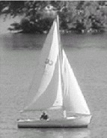
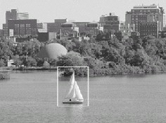
Review
Template Matching in Digital Image Processing
  To find small parts of an image which match a template image.
  Its application includes image retrieval, image recognition, and object detection etc.
  The similarity measure can be expressed in term of Euclidean distance or cross correlation.

Slide 4
Review
Similarity Measure
  Euclidean distance
    As a measure, how well an arbitrary pattern of greyvalues, a template g(x,y), matches a given image f(x,y), one uses a distance function. The minima of these measures are the best match. In the case of the Euclidean distance
  Cross correlation
  Time Complexity O(mnMN) (Not considering scaling)
Notes:
rand('normal')
X=rand(100,100);
x=X(30:40,30:40);
subplot(221)
mesh(X)
subplot(222)
E=zeros(90,90);
mesh(x)
for i=1:90
for j=1:90
E(i,j)=sum(sum(abs(X(i:i+10,j:j+10)-x)));
end
end
subplot(223)
mesh(E)
subplot(224)
mesh(imconv(X,x))

Slide 5
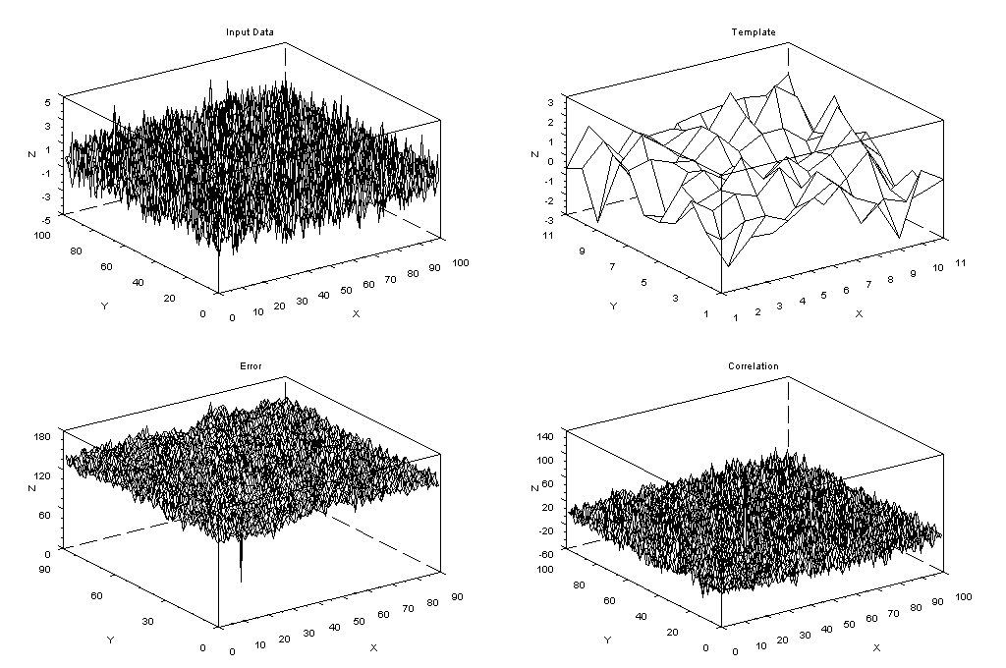
Review
Similarity Measure
Notes:
rand('normal')
X=rand(100,100);
x=X(30:40,30:40);
subplot(221)
title('Input Data')
mesh(X)
subplot(222)
title('Template')
E=zeros(90,90);
mesh(x)
for i=1:90
for j=1:90
E(i,j)=sum(sum(abs(X(i:i+10,j:j+10)-x)));
end
end
subplot(223)
title('Error')
mesh(E)
subplot(224)
title('Correlation')
mesh(imconv(X,x))

Slide 6
Review
Other template matching Methods
  The coarse to fine approach
  Fast Fourier transform (FFT) with cross correlations
  Using the upper boundary of the similarity to eliminate unnecessary calculations
  Approximating a image or template by a function

Slide 7
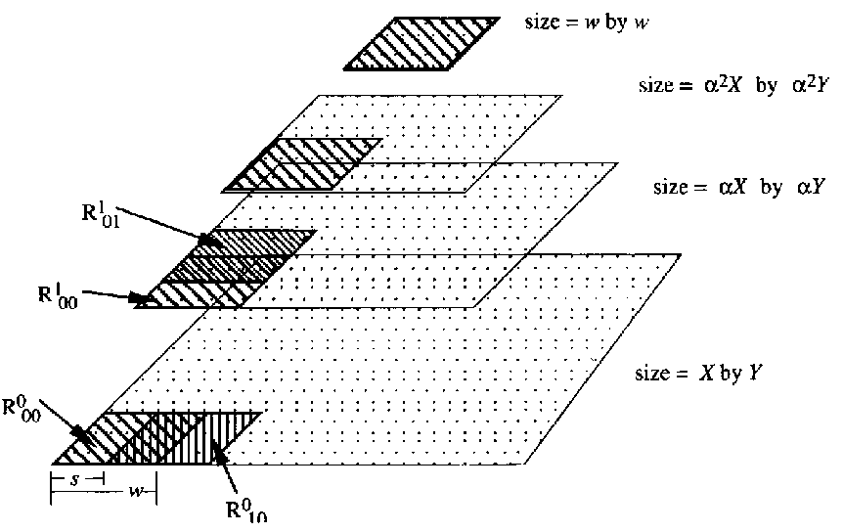
Review
The coarse to fine approach
  This strategy uses a low-resolution template or input image for initial coarse matching. Matching between high-resolution template and input images is applied for fine matching only when there is high similarity in the coarse matching.
  this strategy cannot always find the most similar part in the fine matching since the other part may be detected in coarse matching.

Slide 8


Review
Fast Fourier transform (FFT) with cross correlations
  Based on the following fact
  Time Complexity O(MN*log(MN))
Notes:
rand('normal')
X=rand(100,100);
x=zeros(100,100);
x(1:11,1:11)=X(30:40,30:40);
FX=fft2(X);
Fx=fft2(x);
FXC=conj(FX);
FXC_Fx=FXC.*Fx;
subplot(221)
mesh(abs(FX))
subplot(222)
mesh(abs(Fx))
subplot(223)
mesh(abs(FXC_Fx))
subplot(224)
mesh(abs(fft2(FXC_Fx)))
[r,c]=find(C==max(C))

Slide 9
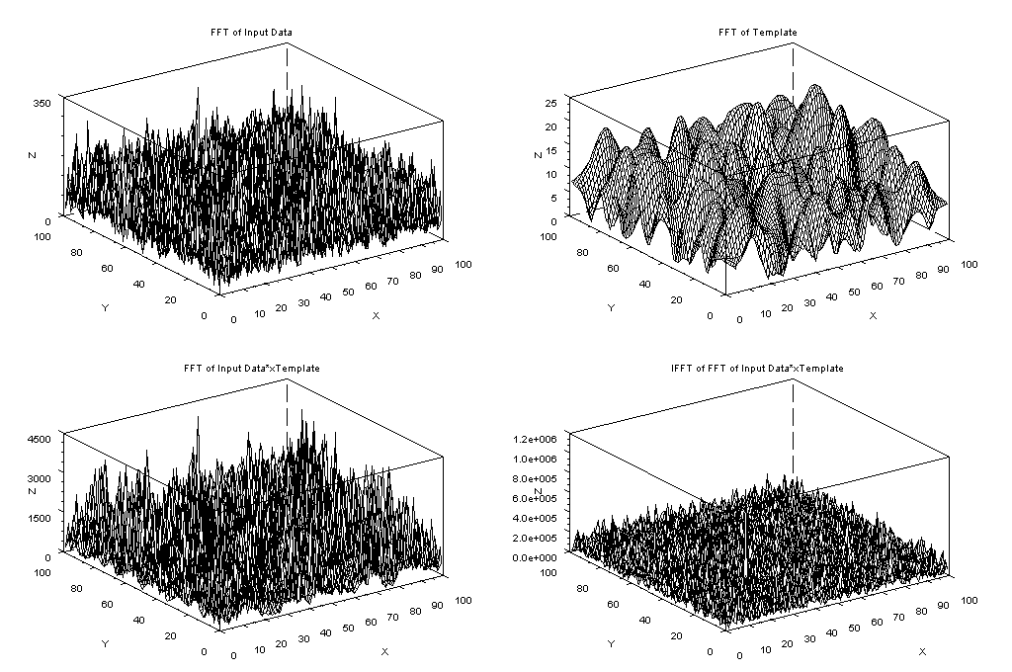
Review
Notes:
rand('normal')
X=rand(100,100);
x=zeros(100,100);
x(1:11,1:11)=X(30:40,30:40);
FX=fft2(X);
Fx=fft2(x);
FXC=conj(FX);
FXC_Fx=FXC.*Fx;
subplot(221)
title('FFT of Input Data')
mesh(abs(FX))
subplot(222)
title('FFT of Template')
mesh(abs(Fx))
subplot(223)
title('FFT of Input Data*xTemplate')
mesh(abs(FXC_Fx))
subplot(224)
title('IFFT of FFT of Input Data*xTemplate')
mesh(abs(fft2(FXC_Fx)))
[r,c]=find(C==max(C))

Slide 10
Review
Upper boundary Pruning
  The algorithm prunes regions whose matching upper bounds are below a given threshold.
  Gharavi–Alkhansari (2001) combined this strategy with the coarse-to-fine strategy, and proposed a method for estimating a threshold in the coarse search and pruning the candidates in the fine search.
  Stefano and Mattoccia (2003) proposed an algorithm by defining an upper-boundary function for normalized cross correlation, using the inequality of arithmetic and geometric means.
Notes:
rand('normal')
X=rand(100,100);
x=zeros(100,100);
x(1:11,1:11)=X(30:40,30:40);
FX=fft2(X);
Fx=fft2(x);
FXC=conj(FX);
FXC_Fx=FXC.*Fx;
subplot(221)
mesh(abs(FX))
subplot(222)
mesh(abs(Fx))
subplot(223)
mesh(abs(FXC_Fx))
subplot(224)
mesh(abs(fft2(FXC_Fx)))
[r,c]=find(C==max(C))

Slide 11

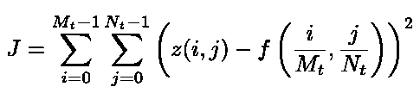
Review
Approximating a image or template by a function
  Using a polynomial to approximate the image or template
  Let z(i,j) be the intensity of the image (i=0~Mt-1, j=0~Nt-1), f(x,y) be the polynomial of degree d that approximates z (x=0~1,y=0~1).
  Least square error method is usually used to solve this problem. It takess O(MtNt*d⁴) time complexity to arrange the following equation:
Notes:
im=imread('C:\Program Files\scilab-4.1\contrib\siptoolbox\images\disks2.bmp');
[h,w]=size(im)
Tem=im(15:34,44:68);
[X,Y]=meshgrid(linspace(-1,1,w),linspace(-1,1,h));
XX=matrix(X, w*h,1);
YY=matrix(Y, w*h,1);
one=ones(w*h,1);
X1=XX;
Y1=YY;
X2=XX.^2;
X1Y1=XX.*YY;
Y2=YY.^2;
X3=XX.^3;
X2Y1=(XX.^2).*(YY.^1);
X1Y2=(XX.^1).*(YY.^2);
Y3=YY.^3;
X4=XX.^4;
X3Y1=(XX.^3).*(YY.^1);
X2Y2=(XX.^2).*(YY.^2);
X1Y3=(XX.^1).*(YY.^3);
Y4=YY.^4;
X5=XX.^5;
X4Y1=(XX.^4).*(YY.^1);
X3Y2=(XX.^3).*(YY.^2);
X2Y3=(XX.^2).*(YY.^3);
X1Y4=(XX.^1).*(YY.^4);
Y5=YY.^5;
X6=XX.^6;
X5Y1=(XX.^5).*(YY.^1);
X4Y2=(XX.^4).*(YY.^2);
X3Y3=(XX.^3).*(YY.^3);
X2Y4=(XX.^2).*(YY.^4);
X1Y5=(XX.^1).*(YY.^5);
Y6=YY.^6;
X7=XX.^7;
X6Y1=(XX.^6).*(YY.^1);
X5Y2=(XX.^5).*(YY.^2);
X4Y3=(XX.^4).*(YY.^3);
X3Y4=(XX.^3).*(YY.^4);
X2Y5=(XX.^2).*(YY.^5);
X1Y6=(XX.^1).*(YY.^6);
Y7=YY.^7;
X8=XX.^8;
X7Y1=(XX.^7).*(YY.^1);
X6Y2=(XX.^6).*(YY.^2);
X5Y3=(XX.^5).*(YY.^3);
X4Y4=(XX.^4).*(YY.^4);
X3Y5=(XX.^3).*(YY.^5);
X2Y6=(XX.^2).*(YY.^6);
X1Y7=(XX.^1).*(YY.^7);
Y8=YY.^8;
X9=XX.^9;
X8Y1=(XX.^8).*(YY.^1);
X7Y2=(XX.^7).*(YY.^2);
X6Y3=(XX.^6).*(YY.^3);
X5Y4=(XX.^5).*(YY.^4);
X4Y5=(XX.^4).*(YY.^5);
X3Y6=(XX.^3).*(YY.^6);
X2Y7=(XX.^2).*(YY.^7);
X1Y8=(XX.^1).*(YY.^8);
Y9=YY.^9;
X10=XX.^10;
X9Y1=(XX.^9).*(YY.^1);
X8Y2=(XX.^8).*(YY.^2);
X7Y3=(XX.^7).*(YY.^3);
X6Y4=(XX.^6).*(YY.^4);
X5Y5=(XX.^5).*(YY.^5);
X4Y6=(XX.^4).*(YY.^6);
X3Y7=(XX.^3).*(YY.^7);
X2Y8=(XX.^2).*(YY.^8);
X1Y9=(XX.^1).*(YY.^9);
Y10=YY.^10;
X11=XX.^11;
X10Y1=(XX.^10).*(YY.^1);
X9Y2=(XX.^9).*(YY.^2);
X8Y3=(XX.^8).*(YY.^3);
X7Y4=(XX.^7).*(YY.^4);
X6Y5=(XX.^6).*(YY.^5);
X5Y6=(XX.^5).*(YY.^6);
X4Y7=(XX.^4).*(YY.^7);
X3Y8=(XX.^3).*(YY.^8);
X2Y9=(XX.^2).*(YY.^9);
X1Y10=(XX.^1).*(YY.^10);
Y11=YY.^11;
X12=XX.^12;
X11Y1=(XX.^11).*(YY.^1);
X10Y2=(XX.^10).*(YY.^2);
X9Y3=(XX.^9).*(YY.^3);
X8Y4=(XX.^8).*(YY.^4);
X7Y5=(XX.^7).*(YY.^5);
X6Y6=(XX.^6).*(YY.^6);
X5Y7=(XX.^5).*(YY.^7);
X4Y8=(XX.^4).*(YY.^8);
X3Y9=(XX.^3).*(YY.^9);
X2Y10=(XX.^2).*(YY.^10);
X1Y11=(XX.^1).*(YY.^11);
Y12=YY.^12;
//X13=XX.^13;
//X12Y1=(XX.^12).*(YY.^1);
//X11Y2=(XX.^11).*(YY.^2);
//X10Y3=(XX.^10).*(YY.^3);
//X9Y4=(XX.^9).*(YY.^4);
//X8Y5=(XX.^8).*(YY.^5);
//X7Y6=(XX.^7).*(YY.^6);
//X6Y7=(XX.^6).*(YY.^7);
//X5Y8=(XX.^5).*(YY.^8);
//X4Y9=(XX.^4).*(YY.^9);
//X3Y10=(XX.^3).*(YY.^10);
//X2Y11=(XX.^2).*(YY.^11);
//X1Y12=(XX.^1).*(YY.^12);
//Y13=YY.^13;
//X14=XX.^14;
//X13Y1=(XX.^13).*(YY.^1);
//X12Y2=(XX.^12).*(YY.^2);
//X11Y3=(XX.^11).*(YY.^3);
//X10Y4=(XX.^10).*(YY.^4);
//X9Y5=(XX.^9).*(YY.^5);
//X8Y6=(XX.^8).*(YY.^6);
//X7Y7=(XX.^7).*(YY.^7);
//X6Y8=(XX.^6).*(YY.^8);
//X5Y9=(XX.^5).*(YY.^9);
//X4Y10=(XX.^4).*(YY.^10);
//X3Y11=(XX.^3).*(YY.^11);
//X2Y12=(XX.^2).*(YY.^12);
//X1Y13=(XX.^1).*(YY.^13);
//Y14=YY.^13;
//X15=XX.^15;
//X14Y1=(XX.^14).*(YY.^1);
//X13Y2=(XX.^13).*(YY.^2);
//X12Y3=(XX.^12).*(YY.^3);
//X11Y4=(XX.^11).*(YY.^4);
//X10Y5=(XX.^10).*(YY.^5);
//X9Y6=(XX.^9).*(YY.^6);
//X8Y7=(XX.^8).*(YY.^7);
//X7Y8=(XX.^7).*(YY.^8);
//X6Y9=(XX.^6).*(YY.^9);
//X5Y10=(XX.^5).*(YY.^10);
//X4Y11=(XX.^4).*(YY.^11);
//X3Y12=(XX.^3).*(YY.^12);
//X2Y13=(XX.^2).*(YY.^13);
//X1Y14=(XX.^1).*(YY.^14);
//Y15=YY.^15;
//X16=XX.^16;
//X15Y1=(XX.^15).*(YY.^1);
//X14Y2=(XX.^14).*(YY.^2);
//X13Y3=(XX.^13).*(YY.^3);
//X12Y4=(XX.^12).*(YY.^4);
//X11Y5=(XX.^11).*(YY.^5);
//X10Y6=(XX.^10).*(YY.^6);
//X9Y7=(XX.^9).*(YY.^7);
//X8Y8=(XX.^8).*(YY.^8);
//X7Y9=(XX.^7).*(YY.^9);
//X6Y10=(XX.^6).*(YY.^10);
//X5Y11=(XX.^5).*(YY.^11);
//X4Y12=(XX.^4).*(YY.^12);
//X3Y13=(XX.^3).*(YY.^13);
//X2Y14=(XX.^2).*(YY.^14);
//X1Y15=(XX.^1).*(YY.^15);
//Y16=YY.^16;
//scf(0)
subplot(221)
title('Original Image')
mesh(im)
M8=[one,X1,Y1,X2,X1Y1,Y2,X3,X2Y1,X1Y2,Y3,X4,X3Y1,X2Y2,X1Y3,Y4,X5,X4Y1,X3Y2,X2Y3,X1Y4,Y5,X6,X5Y1,X4Y2,X3Y3,X2Y4,X1Y5,Y6,X7,X6Y1,X5Y2,X4Y3,X3Y4,X2Y5,X1Y6,Y7,X8,X7Y1,X6Y2,X5Y3,X4Y4,X3Y5,X2Y6,X1Y7,Y8];
//scf(1)
subplot(222)
title('Polynomial Order:8')
a8=inv(M8'*M8)*M8'*matrix(im,w*h,1);
mesh(matrix(M8*a8,h,w))
M10=[one,X1,Y1,X2,X1Y1,Y2,X3,X2Y1,X1Y2,Y3,X4,X3Y1,X2Y2,X1Y3,Y4,X5,X4Y1,X3Y2,X2Y3,X1Y4,Y5,X6,X5Y1,X4Y2,X3Y3,X2Y4,X1Y5,Y6,X7,X6Y1,X5Y2,X4Y3,X3Y4,X2Y5,X1Y6,Y7,X8,X7Y1,X6Y2,X5Y3,X4Y4,X3Y5,X2Y6,X1Y7,Y8,X9,X8Y1,X7Y2,X6Y3,X5Y4,X4Y5,X3Y6,X2Y7,X1Y8,Y9,X10,X9Y1,X8Y2,X7Y3,X6Y4,X5Y5,X4Y6,X3Y7,X2Y8,X1Y9,Y10];
//scf(2)
subplot(223)
title('Polynomial Order:10')
a10=inv(M10'*M10)*M10'*matrix(im,w*h,1);
mesh(matrix(M10*a10,h,w))
M12=[one,X1,Y1,X2,X1Y1,Y2,X3,X2Y1,X1Y2,Y3,X4,X3Y1,X2Y2,X1Y3,Y4,X5,X4Y1,X3Y2,X2Y3,X1Y4,Y5,X6,X5Y1,X4Y2,X3Y3,X2Y4,X1Y5,Y6,X7,X6Y1,X5Y2,X4Y3,X3Y4,X2Y5,X1Y6,Y7,X8,X7Y1,X6Y2,X5Y3,X4Y4,X3Y5,X2Y6,X1Y7,Y8,X9,X8Y1,X7Y2,X6Y3,X5Y4,X4Y5,X3Y6,X2Y7,X1Y8,Y9,X10,X9Y1,X8Y2,X7Y3,X6Y4,X5Y5,X4Y6,X3Y7,X2Y8,X1Y9,Y10,X11,X10Y1,X9Y2,X8Y3,X7Y4,X6Y5,X5Y6,X4Y7,X3Y8,X2Y9,X1Y10,Y11,X12,X11Y1,X10Y2,X9Y3,X8Y4,X7Y5,X6Y6,X5Y7,X4Y8,X3Y9,X2Y10,X1Y11,Y12];
//scf(3)
subplot(224)
title('Polynomial Order:12')
a12=inv(M12'*M12)*M12'*matrix(im,w*h,1);
mesh(matrix(M12*a12,h,w))
str1='M16=[one,X1,Y1,X2,X1Y1,Y2,X3,X2Y1,X1Y2,Y3,X4,X3Y1,X2Y2,X1Y3,Y4,X5,X4Y1,X3Y2,X2Y3,X1Y4,Y5,X6,X5Y1,X4Y2,X3Y3,X2Y4,X1Y5,Y6,X7,X6Y1,X5Y2,X4Y3,X3Y4,X2Y5,X1Y6,Y7,X8,X7Y1,X6Y2,X5Y3,X4Y4,X3Y5,X2Y6,X1Y7,Y8,X9,X8Y1,X7Y2,X6Y3,X5Y4,X4Y5,X3Y6,X2Y7,X1Y8,Y9,X10,X9Y1,X8Y2,X7Y3,X6Y4,X5Y5,X4Y6,X3Y7,X2Y8,X1Y9,Y10,X11,X10Y1,X9Y2,X8Y3,X7Y4,X6Y5,X5Y6,X4Y7,X3Y8,X2Y9,X1Y10,Y11,X12,X11Y1,X10Y2,X9Y3,X8Y4,X7Y5,X6Y6,X5Y7,X4Y8,X3Y9,X2Y10,X1Y11,Y12,X13,X12Y1,X11Y2,X10Y3,X9Y4,X8Y5,X7Y6,X6Y7,X5Y8,X4Y9,X3Y10,X2Y11,X1Y12,';
str2='Y13,X14,X13Y1,X12Y2,X11Y3,X10Y4,X9Y5,X8Y6,X7Y7,X6Y8,X5Y9,X4Y10,X3Y11,X2Y12,X1Y13,Y14,X15,X14Y1,X13Y2,X12Y3,X11Y4,X10Y5,X9Y6,X8Y7,X7Y8,X6Y9,X5Y10,X4Y11,X3Y12,X2Y13,X1Y14,Y15,X16,X15Y1,X14Y2,X13Y3,X12Y4,X11Y5,X10Y6,X9Y7,X8Y8,X7Y9,X6Y10,X5Y11,X4Y12,X3Y13,X2Y14,X1Y15,Y16];'
str=str1+str2;
execstr(str)
scf(2)
//a16=inv(M16'*M16)*M16'*matrix(im,w*h,1)
//mesh(matrix(M16*a16,h,w))

Slide 12
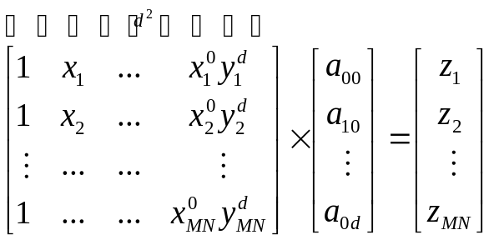
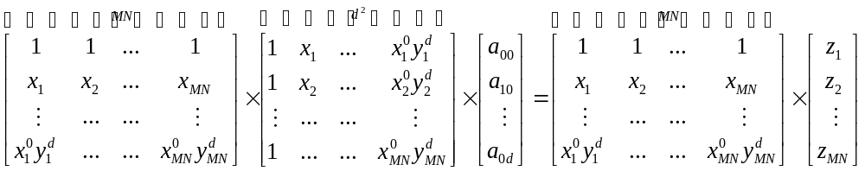
Review
Time complexity to arrange the following equation (O(MtNt*d⁴) )
Notes:
im=imread('C:\Program Files\scilab-4.1\contrib\siptoolbox\images\disks2.bmp');
[h,w]=size(im)
Tem=im(15:34,44:68);
[X,Y]=meshgrid(linspace(-1,1,w),linspace(-1,1,h));
XX=matrix(X, w*h,1);
YY=matrix(Y, w*h,1);
one=ones(w*h,1);
X1=XX;
Y1=YY;
X2=XX.^2;
X1Y1=XX.*YY;
Y2=YY.^2;
X3=XX.^3;
X2Y1=(XX.^2).*(YY.^1);
X1Y2=(XX.^1).*(YY.^2);
Y3=YY.^3;
X4=XX.^4;
X3Y1=(XX.^3).*(YY.^1);
X2Y2=(XX.^2).*(YY.^2);
X1Y3=(XX.^1).*(YY.^3);
Y4=YY.^4;
X5=XX.^5;
X4Y1=(XX.^4).*(YY.^1);
X3Y2=(XX.^3).*(YY.^2);
X2Y3=(XX.^2).*(YY.^3);
X1Y4=(XX.^1).*(YY.^4);
Y5=YY.^5;
X6=XX.^6;
X5Y1=(XX.^5).*(YY.^1);
X4Y2=(XX.^4).*(YY.^2);
X3Y3=(XX.^3).*(YY.^3);
X2Y4=(XX.^2).*(YY.^4);
X1Y5=(XX.^1).*(YY.^5);
Y6=YY.^6;
X7=XX.^7;
X6Y1=(XX.^6).*(YY.^1);
X5Y2=(XX.^5).*(YY.^2);
X4Y3=(XX.^4).*(YY.^3);
X3Y4=(XX.^3).*(YY.^4);
X2Y5=(XX.^2).*(YY.^5);
X1Y6=(XX.^1).*(YY.^6);
Y7=YY.^7;
X8=XX.^8;
X7Y1=(XX.^7).*(YY.^1);
X6Y2=(XX.^6).*(YY.^2);
X5Y3=(XX.^5).*(YY.^3);
X4Y4=(XX.^4).*(YY.^4);
X3Y5=(XX.^3).*(YY.^5);
X2Y6=(XX.^2).*(YY.^6);
X1Y7=(XX.^1).*(YY.^7);
Y8=YY.^8;
X9=XX.^9;
X8Y1=(XX.^8).*(YY.^1);
X7Y2=(XX.^7).*(YY.^2);
X6Y3=(XX.^6).*(YY.^3);
X5Y4=(XX.^5).*(YY.^4);
X4Y5=(XX.^4).*(YY.^5);
X3Y6=(XX.^3).*(YY.^6);
X2Y7=(XX.^2).*(YY.^7);
X1Y8=(XX.^1).*(YY.^8);
Y9=YY.^9;
X10=XX.^10;
X9Y1=(XX.^9).*(YY.^1);
X8Y2=(XX.^8).*(YY.^2);
X7Y3=(XX.^7).*(YY.^3);
X6Y4=(XX.^6).*(YY.^4);
X5Y5=(XX.^5).*(YY.^5);
X4Y6=(XX.^4).*(YY.^6);
X3Y7=(XX.^3).*(YY.^7);
X2Y8=(XX.^2).*(YY.^8);
X1Y9=(XX.^1).*(YY.^9);
Y10=YY.^10;
X11=XX.^11;
X10Y1=(XX.^10).*(YY.^1);
X9Y2=(XX.^9).*(YY.^2);
X8Y3=(XX.^8).*(YY.^3);
X7Y4=(XX.^7).*(YY.^4);
X6Y5=(XX.^6).*(YY.^5);
X5Y6=(XX.^5).*(YY.^6);
X4Y7=(XX.^4).*(YY.^7);
X3Y8=(XX.^3).*(YY.^8);
X2Y9=(XX.^2).*(YY.^9);
X1Y10=(XX.^1).*(YY.^10);
Y11=YY.^11;
X12=XX.^12;
X11Y1=(XX.^11).*(YY.^1);
X10Y2=(XX.^10).*(YY.^2);
X9Y3=(XX.^9).*(YY.^3);
X8Y4=(XX.^8).*(YY.^4);
X7Y5=(XX.^7).*(YY.^5);
X6Y6=(XX.^6).*(YY.^6);
X5Y7=(XX.^5).*(YY.^7);
X4Y8=(XX.^4).*(YY.^8);
X3Y9=(XX.^3).*(YY.^9);
X2Y10=(XX.^2).*(YY.^10);
X1Y11=(XX.^1).*(YY.^11);
Y12=YY.^12;
//X13=XX.^13;
//X12Y1=(XX.^12).*(YY.^1);
//X11Y2=(XX.^11).*(YY.^2);
//X10Y3=(XX.^10).*(YY.^3);
//X9Y4=(XX.^9).*(YY.^4);
//X8Y5=(XX.^8).*(YY.^5);
//X7Y6=(XX.^7).*(YY.^6);
//X6Y7=(XX.^6).*(YY.^7);
//X5Y8=(XX.^5).*(YY.^8);
//X4Y9=(XX.^4).*(YY.^9);
//X3Y10=(XX.^3).*(YY.^10);
//X2Y11=(XX.^2).*(YY.^11);
//X1Y12=(XX.^1).*(YY.^12);
//Y13=YY.^13;
//X14=XX.^14;
//X13Y1=(XX.^13).*(YY.^1);
//X12Y2=(XX.^12).*(YY.^2);
//X11Y3=(XX.^11).*(YY.^3);
//X10Y4=(XX.^10).*(YY.^4);
//X9Y5=(XX.^9).*(YY.^5);
//X8Y6=(XX.^8).*(YY.^6);
//X7Y7=(XX.^7).*(YY.^7);
//X6Y8=(XX.^6).*(YY.^8);
//X5Y9=(XX.^5).*(YY.^9);
//X4Y10=(XX.^4).*(YY.^10);
//X3Y11=(XX.^3).*(YY.^11);
//X2Y12=(XX.^2).*(YY.^12);
//X1Y13=(XX.^1).*(YY.^13);
//Y14=YY.^13;
//X15=XX.^15;
//X14Y1=(XX.^14).*(YY.^1);
//X13Y2=(XX.^13).*(YY.^2);
//X12Y3=(XX.^12).*(YY.^3);
//X11Y4=(XX.^11).*(YY.^4);
//X10Y5=(XX.^10).*(YY.^5);
//X9Y6=(XX.^9).*(YY.^6);
//X8Y7=(XX.^8).*(YY.^7);
//X7Y8=(XX.^7).*(YY.^8);
//X6Y9=(XX.^6).*(YY.^9);
//X5Y10=(XX.^5).*(YY.^10);
//X4Y11=(XX.^4).*(YY.^11);
//X3Y12=(XX.^3).*(YY.^12);
//X2Y13=(XX.^2).*(YY.^13);
//X1Y14=(XX.^1).*(YY.^14);
//Y15=YY.^15;
//X16=XX.^16;
//X15Y1=(XX.^15).*(YY.^1);
//X14Y2=(XX.^14).*(YY.^2);
//X13Y3=(XX.^13).*(YY.^3);
//X12Y4=(XX.^12).*(YY.^4);
//X11Y5=(XX.^11).*(YY.^5);
//X10Y6=(XX.^10).*(YY.^6);
//X9Y7=(XX.^9).*(YY.^7);
//X8Y8=(XX.^8).*(YY.^8);
//X7Y9=(XX.^7).*(YY.^9);
//X6Y10=(XX.^6).*(YY.^10);
//X5Y11=(XX.^5).*(YY.^11);
//X4Y12=(XX.^4).*(YY.^12);
//X3Y13=(XX.^3).*(YY.^13);
//X2Y14=(XX.^2).*(YY.^14);
//X1Y15=(XX.^1).*(YY.^15);
//Y16=YY.^16;
//scf(0)
subplot(221)
title('Original Image')
mesh(im)
M8=[one,X1,Y1,X2,X1Y1,Y2,X3,X2Y1,X1Y2,Y3,X4,X3Y1,X2Y2,X1Y3,Y4,X5,X4Y1,X3Y2,X2Y3,X1Y4,Y5,X6,X5Y1,X4Y2,X3Y3,X2Y4,X1Y5,Y6,X7,X6Y1,X5Y2,X4Y3,X3Y4,X2Y5,X1Y6,Y7,X8,X7Y1,X6Y2,X5Y3,X4Y4,X3Y5,X2Y6,X1Y7,Y8];
//scf(1)
subplot(222)
title('Polynomial Order:8')
a8=inv(M8'*M8)*M8'*matrix(im,w*h,1);
mesh(matrix(M8*a8,h,w))
M10=[one,X1,Y1,X2,X1Y1,Y2,X3,X2Y1,X1Y2,Y3,X4,X3Y1,X2Y2,X1Y3,Y4,X5,X4Y1,X3Y2,X2Y3,X1Y4,Y5,X6,X5Y1,X4Y2,X3Y3,X2Y4,X1Y5,Y6,X7,X6Y1,X5Y2,X4Y3,X3Y4,X2Y5,X1Y6,Y7,X8,X7Y1,X6Y2,X5Y3,X4Y4,X3Y5,X2Y6,X1Y7,Y8,X9,X8Y1,X7Y2,X6Y3,X5Y4,X4Y5,X3Y6,X2Y7,X1Y8,Y9,X10,X9Y1,X8Y2,X7Y3,X6Y4,X5Y5,X4Y6,X3Y7,X2Y8,X1Y9,Y10];
//scf(2)
subplot(223)
title('Polynomial Order:10')
a10=inv(M10'*M10)*M10'*matrix(im,w*h,1);
mesh(matrix(M10*a10,h,w))
M12=[one,X1,Y1,X2,X1Y1,Y2,X3,X2Y1,X1Y2,Y3,X4,X3Y1,X2Y2,X1Y3,Y4,X5,X4Y1,X3Y2,X2Y3,X1Y4,Y5,X6,X5Y1,X4Y2,X3Y3,X2Y4,X1Y5,Y6,X7,X6Y1,X5Y2,X4Y3,X3Y4,X2Y5,X1Y6,Y7,X8,X7Y1,X6Y2,X5Y3,X4Y4,X3Y5,X2Y6,X1Y7,Y8,X9,X8Y1,X7Y2,X6Y3,X5Y4,X4Y5,X3Y6,X2Y7,X1Y8,Y9,X10,X9Y1,X8Y2,X7Y3,X6Y4,X5Y5,X4Y6,X3Y7,X2Y8,X1Y9,Y10,X11,X10Y1,X9Y2,X8Y3,X7Y4,X6Y5,X5Y6,X4Y7,X3Y8,X2Y9,X1Y10,Y11,X12,X11Y1,X10Y2,X9Y3,X8Y4,X7Y5,X6Y6,X5Y7,X4Y8,X3Y9,X2Y10,X1Y11,Y12];
//scf(3)
subplot(224)
title('Polynomial Order:12')
a12=inv(M12'*M12)*M12'*matrix(im,w*h,1);
mesh(matrix(M12*a12,h,w))
str1='M16=[one,X1,Y1,X2,X1Y1,Y2,X3,X2Y1,X1Y2,Y3,X4,X3Y1,X2Y2,X1Y3,Y4,X5,X4Y1,X3Y2,X2Y3,X1Y4,Y5,X6,X5Y1,X4Y2,X3Y3,X2Y4,X1Y5,Y6,X7,X6Y1,X5Y2,X4Y3,X3Y4,X2Y5,X1Y6,Y7,X8,X7Y1,X6Y2,X5Y3,X4Y4,X3Y5,X2Y6,X1Y7,Y8,X9,X8Y1,X7Y2,X6Y3,X5Y4,X4Y5,X3Y6,X2Y7,X1Y8,Y9,X10,X9Y1,X8Y2,X7Y3,X6Y4,X5Y5,X4Y6,X3Y7,X2Y8,X1Y9,Y10,X11,X10Y1,X9Y2,X8Y3,X7Y4,X6Y5,X5Y6,X4Y7,X3Y8,X2Y9,X1Y10,Y11,X12,X11Y1,X10Y2,X9Y3,X8Y4,X7Y5,X6Y6,X5Y7,X4Y8,X3Y9,X2Y10,X1Y11,Y12,X13,X12Y1,X11Y2,X10Y3,X9Y4,X8Y5,X7Y6,X6Y7,X5Y8,X4Y9,X3Y10,X2Y11,X1Y12,';
str2='Y13,X14,X13Y1,X12Y2,X11Y3,X10Y4,X9Y5,X8Y6,X7Y7,X6Y8,X5Y9,X4Y10,X3Y11,X2Y12,X1Y13,Y14,X15,X14Y1,X13Y2,X12Y3,X11Y4,X10Y5,X9Y6,X8Y7,X7Y8,X6Y9,X5Y10,X4Y11,X3Y12,X2Y13,X1Y14,Y15,X16,X15Y1,X14Y2,X13Y3,X12Y4,X11Y5,X10Y6,X9Y7,X8Y8,X7Y9,X6Y10,X5Y11,X4Y12,X3Y13,X2Y14,X1Y15,Y16];'
str=str1+str2;
execstr(str)
scf(2)
//a16=inv(M16'*M16)*M16'*matrix(im,w*h,1)
//mesh(matrix(M16*a16,h,w))

Slide 13

Review
Approximating a image or template by a function
  The solution is ( Using Gaussian elimination, time complexity : O(d^6))
  The higher the degree, the closer the polynomial approximates the image or template. However, the truncation error of the inverse matrix calculation may degrade the quality of the approximation.
Notes:
im=imread('C:\Program Files\scilab-4.1\contrib\siptoolbox\images\disks2.bmp');
[h,w]=size(im)
Tem=im(15:34,44:68);
[X,Y]=meshgrid(linspace(-1,1,w),linspace(-1,1,h));
XX=matrix(X, w*h,1);
YY=matrix(Y, w*h,1);
one=ones(w*h,1);
X1=XX;
Y1=YY;
X2=XX.^2;
X1Y1=XX.*YY;
Y2=YY.^2;
X3=XX.^3;
X2Y1=(XX.^2).*(YY.^1);
X1Y2=(XX.^1).*(YY.^2);
Y3=YY.^3;
X4=XX.^4;
X3Y1=(XX.^3).*(YY.^1);
X2Y2=(XX.^2).*(YY.^2);
X1Y3=(XX.^1).*(YY.^3);
Y4=YY.^4;
X5=XX.^5;
X4Y1=(XX.^4).*(YY.^1);
X3Y2=(XX.^3).*(YY.^2);
X2Y3=(XX.^2).*(YY.^3);
X1Y4=(XX.^1).*(YY.^4);
Y5=YY.^5;
X6=XX.^6;
X5Y1=(XX.^5).*(YY.^1);
X4Y2=(XX.^4).*(YY.^2);
X3Y3=(XX.^3).*(YY.^3);
X2Y4=(XX.^2).*(YY.^4);
X1Y5=(XX.^1).*(YY.^5);
Y6=YY.^6;
X7=XX.^7;
X6Y1=(XX.^6).*(YY.^1);
X5Y2=(XX.^5).*(YY.^2);
X4Y3=(XX.^4).*(YY.^3);
X3Y4=(XX.^3).*(YY.^4);
X2Y5=(XX.^2).*(YY.^5);
X1Y6=(XX.^1).*(YY.^6);
Y7=YY.^7;
X8=XX.^8;
X7Y1=(XX.^7).*(YY.^1);
X6Y2=(XX.^6).*(YY.^2);
X5Y3=(XX.^5).*(YY.^3);
X4Y4=(XX.^4).*(YY.^4);
X3Y5=(XX.^3).*(YY.^5);
X2Y6=(XX.^2).*(YY.^6);
X1Y7=(XX.^1).*(YY.^7);
Y8=YY.^8;
X9=XX.^9;
X8Y1=(XX.^8).*(YY.^1);
X7Y2=(XX.^7).*(YY.^2);
X6Y3=(XX.^6).*(YY.^3);
X5Y4=(XX.^5).*(YY.^4);
X4Y5=(XX.^4).*(YY.^5);
X3Y6=(XX.^3).*(YY.^6);
X2Y7=(XX.^2).*(YY.^7);
X1Y8=(XX.^1).*(YY.^8);
Y9=YY.^9;
X10=XX.^10;
X9Y1=(XX.^9).*(YY.^1);
X8Y2=(XX.^8).*(YY.^2);
X7Y3=(XX.^7).*(YY.^3);
X6Y4=(XX.^6).*(YY.^4);
X5Y5=(XX.^5).*(YY.^5);
X4Y6=(XX.^4).*(YY.^6);
X3Y7=(XX.^3).*(YY.^7);
X2Y8=(XX.^2).*(YY.^8);
X1Y9=(XX.^1).*(YY.^9);
Y10=YY.^10;
X11=XX.^11;
X10Y1=(XX.^10).*(YY.^1);
X9Y2=(XX.^9).*(YY.^2);
X8Y3=(XX.^8).*(YY.^3);
X7Y4=(XX.^7).*(YY.^4);
X6Y5=(XX.^6).*(YY.^5);
X5Y6=(XX.^5).*(YY.^6);
X4Y7=(XX.^4).*(YY.^7);
X3Y8=(XX.^3).*(YY.^8);
X2Y9=(XX.^2).*(YY.^9);
X1Y10=(XX.^1).*(YY.^10);
Y11=YY.^11;
X12=XX.^12;
X11Y1=(XX.^11).*(YY.^1);
X10Y2=(XX.^10).*(YY.^2);
X9Y3=(XX.^9).*(YY.^3);
X8Y4=(XX.^8).*(YY.^4);
X7Y5=(XX.^7).*(YY.^5);
X6Y6=(XX.^6).*(YY.^6);
X5Y7=(XX.^5).*(YY.^7);
X4Y8=(XX.^4).*(YY.^8);
X3Y9=(XX.^3).*(YY.^9);
X2Y10=(XX.^2).*(YY.^10);
X1Y11=(XX.^1).*(YY.^11);
Y12=YY.^12;
//X13=XX.^13;
//X12Y1=(XX.^12).*(YY.^1);
//X11Y2=(XX.^11).*(YY.^2);
//X10Y3=(XX.^10).*(YY.^3);
//X9Y4=(XX.^9).*(YY.^4);
//X8Y5=(XX.^8).*(YY.^5);
//X7Y6=(XX.^7).*(YY.^6);
//X6Y7=(XX.^6).*(YY.^7);
//X5Y8=(XX.^5).*(YY.^8);
//X4Y9=(XX.^4).*(YY.^9);
//X3Y10=(XX.^3).*(YY.^10);
//X2Y11=(XX.^2).*(YY.^11);
//X1Y12=(XX.^1).*(YY.^12);
//Y13=YY.^13;
//X14=XX.^14;
//X13Y1=(XX.^13).*(YY.^1);
//X12Y2=(XX.^12).*(YY.^2);
//X11Y3=(XX.^11).*(YY.^3);
//X10Y4=(XX.^10).*(YY.^4);
//X9Y5=(XX.^9).*(YY.^5);
//X8Y6=(XX.^8).*(YY.^6);
//X7Y7=(XX.^7).*(YY.^7);
//X6Y8=(XX.^6).*(YY.^8);
//X5Y9=(XX.^5).*(YY.^9);
//X4Y10=(XX.^4).*(YY.^10);
//X3Y11=(XX.^3).*(YY.^11);
//X2Y12=(XX.^2).*(YY.^12);
//X1Y13=(XX.^1).*(YY.^13);
//Y14=YY.^13;
//X15=XX.^15;
//X14Y1=(XX.^14).*(YY.^1);
//X13Y2=(XX.^13).*(YY.^2);
//X12Y3=(XX.^12).*(YY.^3);
//X11Y4=(XX.^11).*(YY.^4);
//X10Y5=(XX.^10).*(YY.^5);
//X9Y6=(XX.^9).*(YY.^6);
//X8Y7=(XX.^8).*(YY.^7);
//X7Y8=(XX.^7).*(YY.^8);
//X6Y9=(XX.^6).*(YY.^9);
//X5Y10=(XX.^5).*(YY.^10);
//X4Y11=(XX.^4).*(YY.^11);
//X3Y12=(XX.^3).*(YY.^12);
//X2Y13=(XX.^2).*(YY.^13);
//X1Y14=(XX.^1).*(YY.^14);
//Y15=YY.^15;
//X16=XX.^16;
//X15Y1=(XX.^15).*(YY.^1);
//X14Y2=(XX.^14).*(YY.^2);
//X13Y3=(XX.^13).*(YY.^3);
//X12Y4=(XX.^12).*(YY.^4);
//X11Y5=(XX.^11).*(YY.^5);
//X10Y6=(XX.^10).*(YY.^6);
//X9Y7=(XX.^9).*(YY.^7);
//X8Y8=(XX.^8).*(YY.^8);
//X7Y9=(XX.^7).*(YY.^9);
//X6Y10=(XX.^6).*(YY.^10);
//X5Y11=(XX.^5).*(YY.^11);
//X4Y12=(XX.^4).*(YY.^12);
//X3Y13=(XX.^3).*(YY.^13);
//X2Y14=(XX.^2).*(YY.^14);
//X1Y15=(XX.^1).*(YY.^15);
//Y16=YY.^16;
//scf(0)
subplot(221)
title('Original Image')
mesh(im)
M8=[one,X1,Y1,X2,X1Y1,Y2,X3,X2Y1,X1Y2,Y3,X4,X3Y1,X2Y2,X1Y3,Y4,X5,X4Y1,X3Y2,X2Y3,X1Y4,Y5,X6,X5Y1,X4Y2,X3Y3,X2Y4,X1Y5,Y6,X7,X6Y1,X5Y2,X4Y3,X3Y4,X2Y5,X1Y6,Y7,X8,X7Y1,X6Y2,X5Y3,X4Y4,X3Y5,X2Y6,X1Y7,Y8];
//scf(1)
subplot(222)
title('Polynomial Order:8')
a8=inv(M8'*M8)*M8'*matrix(im,w*h,1);
mesh(matrix(M8*a8,h,w))
M10=[one,X1,Y1,X2,X1Y1,Y2,X3,X2Y1,X1Y2,Y3,X4,X3Y1,X2Y2,X1Y3,Y4,X5,X4Y1,X3Y2,X2Y3,X1Y4,Y5,X6,X5Y1,X4Y2,X3Y3,X2Y4,X1Y5,Y6,X7,X6Y1,X5Y2,X4Y3,X3Y4,X2Y5,X1Y6,Y7,X8,X7Y1,X6Y2,X5Y3,X4Y4,X3Y5,X2Y6,X1Y7,Y8,X9,X8Y1,X7Y2,X6Y3,X5Y4,X4Y5,X3Y6,X2Y7,X1Y8,Y9,X10,X9Y1,X8Y2,X7Y3,X6Y4,X5Y5,X4Y6,X3Y7,X2Y8,X1Y9,Y10];
//scf(2)
subplot(223)
title('Polynomial Order:10')
a10=inv(M10'*M10)*M10'*matrix(im,w*h,1);
mesh(matrix(M10*a10,h,w))
M12=[one,X1,Y1,X2,X1Y1,Y2,X3,X2Y1,X1Y2,Y3,X4,X3Y1,X2Y2,X1Y3,Y4,X5,X4Y1,X3Y2,X2Y3,X1Y4,Y5,X6,X5Y1,X4Y2,X3Y3,X2Y4,X1Y5,Y6,X7,X6Y1,X5Y2,X4Y3,X3Y4,X2Y5,X1Y6,Y7,X8,X7Y1,X6Y2,X5Y3,X4Y4,X3Y5,X2Y6,X1Y7,Y8,X9,X8Y1,X7Y2,X6Y3,X5Y4,X4Y5,X3Y6,X2Y7,X1Y8,Y9,X10,X9Y1,X8Y2,X7Y3,X6Y4,X5Y5,X4Y6,X3Y7,X2Y8,X1Y9,Y10,X11,X10Y1,X9Y2,X8Y3,X7Y4,X6Y5,X5Y6,X4Y7,X3Y8,X2Y9,X1Y10,Y11,X12,X11Y1,X10Y2,X9Y3,X8Y4,X7Y5,X6Y6,X5Y7,X4Y8,X3Y9,X2Y10,X1Y11,Y12];
//scf(3)
subplot(224)
title('Polynomial Order:12')
a12=inv(M12'*M12)*M12'*matrix(im,w*h,1);
mesh(matrix(M12*a12,h,w))
str1='M16=[one,X1,Y1,X2,X1Y1,Y2,X3,X2Y1,X1Y2,Y3,X4,X3Y1,X2Y2,X1Y3,Y4,X5,X4Y1,X3Y2,X2Y3,X1Y4,Y5,X6,X5Y1,X4Y2,X3Y3,X2Y4,X1Y5,Y6,X7,X6Y1,X5Y2,X4Y3,X3Y4,X2Y5,X1Y6,Y7,X8,X7Y1,X6Y2,X5Y3,X4Y4,X3Y5,X2Y6,X1Y7,Y8,X9,X8Y1,X7Y2,X6Y3,X5Y4,X4Y5,X3Y6,X2Y7,X1Y8,Y9,X10,X9Y1,X8Y2,X7Y3,X6Y4,X5Y5,X4Y6,X3Y7,X2Y8,X1Y9,Y10,X11,X10Y1,X9Y2,X8Y3,X7Y4,X6Y5,X5Y6,X4Y7,X3Y8,X2Y9,X1Y10,Y11,X12,X11Y1,X10Y2,X9Y3,X8Y4,X7Y5,X6Y6,X5Y7,X4Y8,X3Y9,X2Y10,X1Y11,Y12,X13,X12Y1,X11Y2,X10Y3,X9Y4,X8Y5,X7Y6,X6Y7,X5Y8,X4Y9,X3Y10,X2Y11,X1Y12,';
str2='Y13,X14,X13Y1,X12Y2,X11Y3,X10Y4,X9Y5,X8Y6,X7Y7,X6Y8,X5Y9,X4Y10,X3Y11,X2Y12,X1Y13,Y14,X15,X14Y1,X13Y2,X12Y3,X11Y4,X10Y5,X9Y6,X8Y7,X7Y8,X6Y9,X5Y10,X4Y11,X3Y12,X2Y13,X1Y14,Y15,X16,X15Y1,X14Y2,X13Y3,X12Y4,X11Y5,X10Y6,X9Y7,X8Y8,X7Y9,X6Y10,X5Y11,X4Y12,X3Y13,X2Y14,X1Y15,Y16];'
str=str1+str2;
execstr(str)
scf(2)
//a16=inv(M16'*M16)*M16'*matrix(im,w*h,1)
//mesh(matrix(M16*a16,h,w))

Slide 14
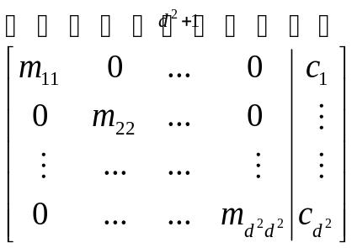

Review
Time complexity to arrange the following equation
  To compute M⁻¹, we need Gaussian elimination. It takes O(d⁶).
Notes:
im=imread('C:\Program Files\scilab-4.1\contrib\siptoolbox\images\disks2.bmp');
[h,w]=size(im)
Tem=im(15:34,44:68);
[X,Y]=meshgrid(linspace(-1,1,w),linspace(-1,1,h));
XX=matrix(X, w*h,1);
YY=matrix(Y, w*h,1);
one=ones(w*h,1);
X1=XX;
Y1=YY;
X2=XX.^2;
X1Y1=XX.*YY;
Y2=YY.^2;
X3=XX.^3;
X2Y1=(XX.^2).*(YY.^1);
X1Y2=(XX.^1).*(YY.^2);
Y3=YY.^3;
X4=XX.^4;
X3Y1=(XX.^3).*(YY.^1);
X2Y2=(XX.^2).*(YY.^2);
X1Y3=(XX.^1).*(YY.^3);
Y4=YY.^4;
X5=XX.^5;
X4Y1=(XX.^4).*(YY.^1);
X3Y2=(XX.^3).*(YY.^2);
X2Y3=(XX.^2).*(YY.^3);
X1Y4=(XX.^1).*(YY.^4);
Y5=YY.^5;
X6=XX.^6;
X5Y1=(XX.^5).*(YY.^1);
X4Y2=(XX.^4).*(YY.^2);
X3Y3=(XX.^3).*(YY.^3);
X2Y4=(XX.^2).*(YY.^4);
X1Y5=(XX.^1).*(YY.^5);
Y6=YY.^6;
X7=XX.^7;
X6Y1=(XX.^6).*(YY.^1);
X5Y2=(XX.^5).*(YY.^2);
X4Y3=(XX.^4).*(YY.^3);
X3Y4=(XX.^3).*(YY.^4);
X2Y5=(XX.^2).*(YY.^5);
X1Y6=(XX.^1).*(YY.^6);
Y7=YY.^7;
X8=XX.^8;
X7Y1=(XX.^7).*(YY.^1);
X6Y2=(XX.^6).*(YY.^2);
X5Y3=(XX.^5).*(YY.^3);
X4Y4=(XX.^4).*(YY.^4);
X3Y5=(XX.^3).*(YY.^5);
X2Y6=(XX.^2).*(YY.^6);
X1Y7=(XX.^1).*(YY.^7);
Y8=YY.^8;
X9=XX.^9;
X8Y1=(XX.^8).*(YY.^1);
X7Y2=(XX.^7).*(YY.^2);
X6Y3=(XX.^6).*(YY.^3);
X5Y4=(XX.^5).*(YY.^4);
X4Y5=(XX.^4).*(YY.^5);
X3Y6=(XX.^3).*(YY.^6);
X2Y7=(XX.^2).*(YY.^7);
X1Y8=(XX.^1).*(YY.^8);
Y9=YY.^9;
X10=XX.^10;
X9Y1=(XX.^9).*(YY.^1);
X8Y2=(XX.^8).*(YY.^2);
X7Y3=(XX.^7).*(YY.^3);
X6Y4=(XX.^6).*(YY.^4);
X5Y5=(XX.^5).*(YY.^5);
X4Y6=(XX.^4).*(YY.^6);
X3Y7=(XX.^3).*(YY.^7);
X2Y8=(XX.^2).*(YY.^8);
X1Y9=(XX.^1).*(YY.^9);
Y10=YY.^10;
X11=XX.^11;
X10Y1=(XX.^10).*(YY.^1);
X9Y2=(XX.^9).*(YY.^2);
X8Y3=(XX.^8).*(YY.^3);
X7Y4=(XX.^7).*(YY.^4);
X6Y5=(XX.^6).*(YY.^5);
X5Y6=(XX.^5).*(YY.^6);
X4Y7=(XX.^4).*(YY.^7);
X3Y8=(XX.^3).*(YY.^8);
X2Y9=(XX.^2).*(YY.^9);
X1Y10=(XX.^1).*(YY.^10);
Y11=YY.^11;
X12=XX.^12;
X11Y1=(XX.^11).*(YY.^1);
X10Y2=(XX.^10).*(YY.^2);
X9Y3=(XX.^9).*(YY.^3);
X8Y4=(XX.^8).*(YY.^4);
X7Y5=(XX.^7).*(YY.^5);
X6Y6=(XX.^6).*(YY.^6);
X5Y7=(XX.^5).*(YY.^7);
X4Y8=(XX.^4).*(YY.^8);
X3Y9=(XX.^3).*(YY.^9);
X2Y10=(XX.^2).*(YY.^10);
X1Y11=(XX.^1).*(YY.^11);
Y12=YY.^12;
//X13=XX.^13;
//X12Y1=(XX.^12).*(YY.^1);
//X11Y2=(XX.^11).*(YY.^2);
//X10Y3=(XX.^10).*(YY.^3);
//X9Y4=(XX.^9).*(YY.^4);
//X8Y5=(XX.^8).*(YY.^5);
//X7Y6=(XX.^7).*(YY.^6);
//X6Y7=(XX.^6).*(YY.^7);
//X5Y8=(XX.^5).*(YY.^8);
//X4Y9=(XX.^4).*(YY.^9);
//X3Y10=(XX.^3).*(YY.^10);
//X2Y11=(XX.^2).*(YY.^11);
//X1Y12=(XX.^1).*(YY.^12);
//Y13=YY.^13;
//X14=XX.^14;
//X13Y1=(XX.^13).*(YY.^1);
//X12Y2=(XX.^12).*(YY.^2);
//X11Y3=(XX.^11).*(YY.^3);
//X10Y4=(XX.^10).*(YY.^4);
//X9Y5=(XX.^9).*(YY.^5);
//X8Y6=(XX.^8).*(YY.^6);
//X7Y7=(XX.^7).*(YY.^7);
//X6Y8=(XX.^6).*(YY.^8);
//X5Y9=(XX.^5).*(YY.^9);
//X4Y10=(XX.^4).*(YY.^10);
//X3Y11=(XX.^3).*(YY.^11);
//X2Y12=(XX.^2).*(YY.^12);
//X1Y13=(XX.^1).*(YY.^13);
//Y14=YY.^13;
//X15=XX.^15;
//X14Y1=(XX.^14).*(YY.^1);
//X13Y2=(XX.^13).*(YY.^2);
//X12Y3=(XX.^12).*(YY.^3);
//X11Y4=(XX.^11).*(YY.^4);
//X10Y5=(XX.^10).*(YY.^5);
//X9Y6=(XX.^9).*(YY.^6);
//X8Y7=(XX.^8).*(YY.^7);
//X7Y8=(XX.^7).*(YY.^8);
//X6Y9=(XX.^6).*(YY.^9);
//X5Y10=(XX.^5).*(YY.^10);
//X4Y11=(XX.^4).*(YY.^11);
//X3Y12=(XX.^3).*(YY.^12);
//X2Y13=(XX.^2).*(YY.^13);
//X1Y14=(XX.^1).*(YY.^14);
//Y15=YY.^15;
//X16=XX.^16;
//X15Y1=(XX.^15).*(YY.^1);
//X14Y2=(XX.^14).*(YY.^2);
//X13Y3=(XX.^13).*(YY.^3);
//X12Y4=(XX.^12).*(YY.^4);
//X11Y5=(XX.^11).*(YY.^5);
//X10Y6=(XX.^10).*(YY.^6);
//X9Y7=(XX.^9).*(YY.^7);
//X8Y8=(XX.^8).*(YY.^8);
//X7Y9=(XX.^7).*(YY.^9);
//X6Y10=(XX.^6).*(YY.^10);
//X5Y11=(XX.^5).*(YY.^11);
//X4Y12=(XX.^4).*(YY.^12);
//X3Y13=(XX.^3).*(YY.^13);
//X2Y14=(XX.^2).*(YY.^14);
//X1Y15=(XX.^1).*(YY.^15);
//Y16=YY.^16;
//scf(0)
subplot(221)
title('Original Image')
mesh(im)
M8=[one,X1,Y1,X2,X1Y1,Y2,X3,X2Y1,X1Y2,Y3,X4,X3Y1,X2Y2,X1Y3,Y4,X5,X4Y1,X3Y2,X2Y3,X1Y4,Y5,X6,X5Y1,X4Y2,X3Y3,X2Y4,X1Y5,Y6,X7,X6Y1,X5Y2,X4Y3,X3Y4,X2Y5,X1Y6,Y7,X8,X7Y1,X6Y2,X5Y3,X4Y4,X3Y5,X2Y6,X1Y7,Y8];
//scf(1)
subplot(222)
title('Polynomial Order:8')
a8=inv(M8'*M8)*M8'*matrix(im,w*h,1);
mesh(matrix(M8*a8,h,w))
M10=[one,X1,Y1,X2,X1Y1,Y2,X3,X2Y1,X1Y2,Y3,X4,X3Y1,X2Y2,X1Y3,Y4,X5,X4Y1,X3Y2,X2Y3,X1Y4,Y5,X6,X5Y1,X4Y2,X3Y3,X2Y4,X1Y5,Y6,X7,X6Y1,X5Y2,X4Y3,X3Y4,X2Y5,X1Y6,Y7,X8,X7Y1,X6Y2,X5Y3,X4Y4,X3Y5,X2Y6,X1Y7,Y8,X9,X8Y1,X7Y2,X6Y3,X5Y4,X4Y5,X3Y6,X2Y7,X1Y8,Y9,X10,X9Y1,X8Y2,X7Y3,X6Y4,X5Y5,X4Y6,X3Y7,X2Y8,X1Y9,Y10];
//scf(2)
subplot(223)
title('Polynomial Order:10')
a10=inv(M10'*M10)*M10'*matrix(im,w*h,1);
mesh(matrix(M10*a10,h,w))
M12=[one,X1,Y1,X2,X1Y1,Y2,X3,X2Y1,X1Y2,Y3,X4,X3Y1,X2Y2,X1Y3,Y4,X5,X4Y1,X3Y2,X2Y3,X1Y4,Y5,X6,X5Y1,X4Y2,X3Y3,X2Y4,X1Y5,Y6,X7,X6Y1,X5Y2,X4Y3,X3Y4,X2Y5,X1Y6,Y7,X8,X7Y1,X6Y2,X5Y3,X4Y4,X3Y5,X2Y6,X1Y7,Y8,X9,X8Y1,X7Y2,X6Y3,X5Y4,X4Y5,X3Y6,X2Y7,X1Y8,Y9,X10,X9Y1,X8Y2,X7Y3,X6Y4,X5Y5,X4Y6,X3Y7,X2Y8,X1Y9,Y10,X11,X10Y1,X9Y2,X8Y3,X7Y4,X6Y5,X5Y6,X4Y7,X3Y8,X2Y9,X1Y10,Y11,X12,X11Y1,X10Y2,X9Y3,X8Y4,X7Y5,X6Y6,X5Y7,X4Y8,X3Y9,X2Y10,X1Y11,Y12];
//scf(3)
subplot(224)
title('Polynomial Order:12')
a12=inv(M12'*M12)*M12'*matrix(im,w*h,1);
mesh(matrix(M12*a12,h,w))
str1='M16=[one,X1,Y1,X2,X1Y1,Y2,X3,X2Y1,X1Y2,Y3,X4,X3Y1,X2Y2,X1Y3,Y4,X5,X4Y1,X3Y2,X2Y3,X1Y4,Y5,X6,X5Y1,X4Y2,X3Y3,X2Y4,X1Y5,Y6,X7,X6Y1,X5Y2,X4Y3,X3Y4,X2Y5,X1Y6,Y7,X8,X7Y1,X6Y2,X5Y3,X4Y4,X3Y5,X2Y6,X1Y7,Y8,X9,X8Y1,X7Y2,X6Y3,X5Y4,X4Y5,X3Y6,X2Y7,X1Y8,Y9,X10,X9Y1,X8Y2,X7Y3,X6Y4,X5Y5,X4Y6,X3Y7,X2Y8,X1Y9,Y10,X11,X10Y1,X9Y2,X8Y3,X7Y4,X6Y5,X5Y6,X4Y7,X3Y8,X2Y9,X1Y10,Y11,X12,X11Y1,X10Y2,X9Y3,X8Y4,X7Y5,X6Y6,X5Y7,X4Y8,X3Y9,X2Y10,X1Y11,Y12,X13,X12Y1,X11Y2,X10Y3,X9Y4,X8Y5,X7Y6,X6Y7,X5Y8,X4Y9,X3Y10,X2Y11,X1Y12,';
str2='Y13,X14,X13Y1,X12Y2,X11Y3,X10Y4,X9Y5,X8Y6,X7Y7,X6Y8,X5Y9,X4Y10,X3Y11,X2Y12,X1Y13,Y14,X15,X14Y1,X13Y2,X12Y3,X11Y4,X10Y5,X9Y6,X8Y7,X7Y8,X6Y9,X5Y10,X4Y11,X3Y12,X2Y13,X1Y14,Y15,X16,X15Y1,X14Y2,X13Y3,X12Y4,X11Y5,X10Y6,X9Y7,X8Y8,X7Y9,X6Y10,X5Y11,X4Y12,X3Y13,X2Y14,X1Y15,Y16];'
str=str1+str2;
execstr(str)
scf(2)
//a16=inv(M16'*M16)*M16'*matrix(im,w*h,1)
//mesh(matrix(M16*a16,h,w))

Slide 15
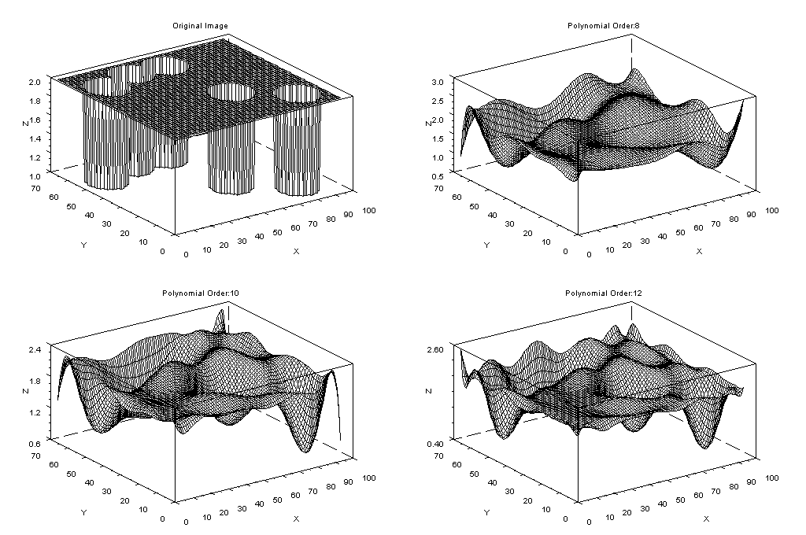

Review
Notes:
im=imread('C:\Program Files\scilab-4.1\contrib\siptoolbox\images\disks2.bmp');
[h,w]=size(im)
Tem=im(15:34,44:68);
[X,Y]=meshgrid(linspace(-1,1,w),linspace(-1,1,h));
XX=matrix(X, w*h,1);
YY=matrix(Y, w*h,1);
one=ones(w*h,1);
X1=XX;
Y1=YY;
X2=XX.^2;
X1Y1=XX.*YY;
Y2=YY.^2;
X3=XX.^3;
X2Y1=(XX.^2).*(YY.^1);
X1Y2=(XX.^1).*(YY.^2);
Y3=YY.^3;
X4=XX.^4;
X3Y1=(XX.^3).*(YY.^1);
X2Y2=(XX.^2).*(YY.^2);
X1Y3=(XX.^1).*(YY.^3);
Y4=YY.^4;
X5=XX.^5;
X4Y1=(XX.^4).*(YY.^1);
X3Y2=(XX.^3).*(YY.^2);
X2Y3=(XX.^2).*(YY.^3);
X1Y4=(XX.^1).*(YY.^4);
Y5=YY.^5;
X6=XX.^6;
X5Y1=(XX.^5).*(YY.^1);
X4Y2=(XX.^4).*(YY.^2);
X3Y3=(XX.^3).*(YY.^3);
X2Y4=(XX.^2).*(YY.^4);
X1Y5=(XX.^1).*(YY.^5);
Y6=YY.^6;
X7=XX.^7;
X6Y1=(XX.^6).*(YY.^1);
X5Y2=(XX.^5).*(YY.^2);
X4Y3=(XX.^4).*(YY.^3);
X3Y4=(XX.^3).*(YY.^4);
X2Y5=(XX.^2).*(YY.^5);
X1Y6=(XX.^1).*(YY.^6);
Y7=YY.^7;
X8=XX.^8;
X7Y1=(XX.^7).*(YY.^1);
X6Y2=(XX.^6).*(YY.^2);
X5Y3=(XX.^5).*(YY.^3);
X4Y4=(XX.^4).*(YY.^4);
X3Y5=(XX.^3).*(YY.^5);
X2Y6=(XX.^2).*(YY.^6);
X1Y7=(XX.^1).*(YY.^7);
Y8=YY.^8;
X9=XX.^9;
X8Y1=(XX.^8).*(YY.^1);
X7Y2=(XX.^7).*(YY.^2);
X6Y3=(XX.^6).*(YY.^3);
X5Y4=(XX.^5).*(YY.^4);
X4Y5=(XX.^4).*(YY.^5);
X3Y6=(XX.^3).*(YY.^6);
X2Y7=(XX.^2).*(YY.^7);
X1Y8=(XX.^1).*(YY.^8);
Y9=YY.^9;
X10=XX.^10;
X9Y1=(XX.^9).*(YY.^1);
X8Y2=(XX.^8).*(YY.^2);
X7Y3=(XX.^7).*(YY.^3);
X6Y4=(XX.^6).*(YY.^4);
X5Y5=(XX.^5).*(YY.^5);
X4Y6=(XX.^4).*(YY.^6);
X3Y7=(XX.^3).*(YY.^7);
X2Y8=(XX.^2).*(YY.^8);
X1Y9=(XX.^1).*(YY.^9);
Y10=YY.^10;
X11=XX.^11;
X10Y1=(XX.^10).*(YY.^1);
X9Y2=(XX.^9).*(YY.^2);
X8Y3=(XX.^8).*(YY.^3);
X7Y4=(XX.^7).*(YY.^4);
X6Y5=(XX.^6).*(YY.^5);
X5Y6=(XX.^5).*(YY.^6);
X4Y7=(XX.^4).*(YY.^7);
X3Y8=(XX.^3).*(YY.^8);
X2Y9=(XX.^2).*(YY.^9);
X1Y10=(XX.^1).*(YY.^10);
Y11=YY.^11;
X12=XX.^12;
X11Y1=(XX.^11).*(YY.^1);
X10Y2=(XX.^10).*(YY.^2);
X9Y3=(XX.^9).*(YY.^3);
X8Y4=(XX.^8).*(YY.^4);
X7Y5=(XX.^7).*(YY.^5);
X6Y6=(XX.^6).*(YY.^6);
X5Y7=(XX.^5).*(YY.^7);
X4Y8=(XX.^4).*(YY.^8);
X3Y9=(XX.^3).*(YY.^9);
X2Y10=(XX.^2).*(YY.^10);
X1Y11=(XX.^1).*(YY.^11);
Y12=YY.^12;
//X13=XX.^13;
//X12Y1=(XX.^12).*(YY.^1);
//X11Y2=(XX.^11).*(YY.^2);
//X10Y3=(XX.^10).*(YY.^3);
//X9Y4=(XX.^9).*(YY.^4);
//X8Y5=(XX.^8).*(YY.^5);
//X7Y6=(XX.^7).*(YY.^6);
//X6Y7=(XX.^6).*(YY.^7);
//X5Y8=(XX.^5).*(YY.^8);
//X4Y9=(XX.^4).*(YY.^9);
//X3Y10=(XX.^3).*(YY.^10);
//X2Y11=(XX.^2).*(YY.^11);
//X1Y12=(XX.^1).*(YY.^12);
//Y13=YY.^13;
//X14=XX.^14;
//X13Y1=(XX.^13).*(YY.^1);
//X12Y2=(XX.^12).*(YY.^2);
//X11Y3=(XX.^11).*(YY.^3);
//X10Y4=(XX.^10).*(YY.^4);
//X9Y5=(XX.^9).*(YY.^5);
//X8Y6=(XX.^8).*(YY.^6);
//X7Y7=(XX.^7).*(YY.^7);
//X6Y8=(XX.^6).*(YY.^8);
//X5Y9=(XX.^5).*(YY.^9);
//X4Y10=(XX.^4).*(YY.^10);
//X3Y11=(XX.^3).*(YY.^11);
//X2Y12=(XX.^2).*(YY.^12);
//X1Y13=(XX.^1).*(YY.^13);
//Y14=YY.^13;
//X15=XX.^15;
//X14Y1=(XX.^14).*(YY.^1);
//X13Y2=(XX.^13).*(YY.^2);
//X12Y3=(XX.^12).*(YY.^3);
//X11Y4=(XX.^11).*(YY.^4);
//X10Y5=(XX.^10).*(YY.^5);
//X9Y6=(XX.^9).*(YY.^6);
//X8Y7=(XX.^8).*(YY.^7);
//X7Y8=(XX.^7).*(YY.^8);
//X6Y9=(XX.^6).*(YY.^9);
//X5Y10=(XX.^5).*(YY.^10);
//X4Y11=(XX.^4).*(YY.^11);
//X3Y12=(XX.^3).*(YY.^12);
//X2Y13=(XX.^2).*(YY.^13);
//X1Y14=(XX.^1).*(YY.^14);
//Y15=YY.^15;
//X16=XX.^16;
//X15Y1=(XX.^15).*(YY.^1);
//X14Y2=(XX.^14).*(YY.^2);
//X13Y3=(XX.^13).*(YY.^3);
//X12Y4=(XX.^12).*(YY.^4);
//X11Y5=(XX.^11).*(YY.^5);
//X10Y6=(XX.^10).*(YY.^6);
//X9Y7=(XX.^9).*(YY.^7);
//X8Y8=(XX.^8).*(YY.^8);
//X7Y9=(XX.^7).*(YY.^9);
//X6Y10=(XX.^6).*(YY.^10);
//X5Y11=(XX.^5).*(YY.^11);
//X4Y12=(XX.^4).*(YY.^12);
//X3Y13=(XX.^3).*(YY.^13);
//X2Y14=(XX.^2).*(YY.^14);
//X1Y15=(XX.^1).*(YY.^15);
//Y16=YY.^16;
//scf(0)
subplot(221)
title('Original Image')
mesh(im)
M8=[one,X1,Y1,X2,X1Y1,Y2,X3,X2Y1,X1Y2,Y3,X4,X3Y1,X2Y2,X1Y3,Y4,X5,X4Y1,X3Y2,X2Y3,X1Y4,Y5,X6,X5Y1,X4Y2,X3Y3,X2Y4,X1Y5,Y6,X7,X6Y1,X5Y2,X4Y3,X3Y4,X2Y5,X1Y6,Y7,X8,X7Y1,X6Y2,X5Y3,X4Y4,X3Y5,X2Y6,X1Y7,Y8];
//scf(1)
subplot(222)
title('Polynomial Order:8')
a8=inv(M8'*M8)*M8'*matrix(im,w*h,1);
mesh(matrix(M8*a8,h,w))
M10=[one,X1,Y1,X2,X1Y1,Y2,X3,X2Y1,X1Y2,Y3,X4,X3Y1,X2Y2,X1Y3,Y4,X5,X4Y1,X3Y2,X2Y3,X1Y4,Y5,X6,X5Y1,X4Y2,X3Y3,X2Y4,X1Y5,Y6,X7,X6Y1,X5Y2,X4Y3,X3Y4,X2Y5,X1Y6,Y7,X8,X7Y1,X6Y2,X5Y3,X4Y4,X3Y5,X2Y6,X1Y7,Y8,X9,X8Y1,X7Y2,X6Y3,X5Y4,X4Y5,X3Y6,X2Y7,X1Y8,Y9,X10,X9Y1,X8Y2,X7Y3,X6Y4,X5Y5,X4Y6,X3Y7,X2Y8,X1Y9,Y10];
//scf(2)
subplot(223)
title('Polynomial Order:10')
a10=inv(M10'*M10)*M10'*matrix(im,w*h,1);
mesh(matrix(M10*a10,h,w))
M12=[one,X1,Y1,X2,X1Y1,Y2,X3,X2Y1,X1Y2,Y3,X4,X3Y1,X2Y2,X1Y3,Y4,X5,X4Y1,X3Y2,X2Y3,X1Y4,Y5,X6,X5Y1,X4Y2,X3Y3,X2Y4,X1Y5,Y6,X7,X6Y1,X5Y2,X4Y3,X3Y4,X2Y5,X1Y6,Y7,X8,X7Y1,X6Y2,X5Y3,X4Y4,X3Y5,X2Y6,X1Y7,Y8,X9,X8Y1,X7Y2,X6Y3,X5Y4,X4Y5,X3Y6,X2Y7,X1Y8,Y9,X10,X9Y1,X8Y2,X7Y3,X6Y4,X5Y5,X4Y6,X3Y7,X2Y8,X1Y9,Y10,X11,X10Y1,X9Y2,X8Y3,X7Y4,X6Y5,X5Y6,X4Y7,X3Y8,X2Y9,X1Y10,Y11,X12,X11Y1,X10Y2,X9Y3,X8Y4,X7Y5,X6Y6,X5Y7,X4Y8,X3Y9,X2Y10,X1Y11,Y12];
//scf(3)
subplot(224)
title('Polynomial Order:12')
a12=inv(M12'*M12)*M12'*matrix(im,w*h,1);
mesh(matrix(M12*a12,h,w))
str1='M16=[one,X1,Y1,X2,X1Y1,Y2,X3,X2Y1,X1Y2,Y3,X4,X3Y1,X2Y2,X1Y3,Y4,X5,X4Y1,X3Y2,X2Y3,X1Y4,Y5,X6,X5Y1,X4Y2,X3Y3,X2Y4,X1Y5,Y6,X7,X6Y1,X5Y2,X4Y3,X3Y4,X2Y5,X1Y6,Y7,X8,X7Y1,X6Y2,X5Y3,X4Y4,X3Y5,X2Y6,X1Y7,Y8,X9,X8Y1,X7Y2,X6Y3,X5Y4,X4Y5,X3Y6,X2Y7,X1Y8,Y9,X10,X9Y1,X8Y2,X7Y3,X6Y4,X5Y5,X4Y6,X3Y7,X2Y8,X1Y9,Y10,X11,X10Y1,X9Y2,X8Y3,X7Y4,X6Y5,X5Y6,X4Y7,X3Y8,X2Y9,X1Y10,Y11,X12,X11Y1,X10Y2,X9Y3,X8Y4,X7Y5,X6Y6,X5Y7,X4Y8,X3Y9,X2Y10,X1Y11,Y12,X13,X12Y1,X11Y2,X10Y3,X9Y4,X8Y5,X7Y6,X6Y7,X5Y8,X4Y9,X3Y10,X2Y11,X1Y12,';
str2='Y13,X14,X13Y1,X12Y2,X11Y3,X10Y4,X9Y5,X8Y6,X7Y7,X6Y8,X5Y9,X4Y10,X3Y11,X2Y12,X1Y13,Y14,X15,X14Y1,X13Y2,X12Y3,X11Y4,X10Y5,X9Y6,X8Y7,X7Y8,X6Y9,X5Y10,X4Y11,X3Y12,X2Y13,X1Y14,Y15,X16,X15Y1,X14Y2,X13Y3,X12Y4,X11Y5,X10Y6,X9Y7,X8Y8,X7Y9,X6Y10,X5Y11,X4Y12,X3Y13,X2Y14,X1Y15,Y16];'
str=str1+str2;
execstr(str)
scf(2)
//a16=inv(M16'*M16)*M16'*matrix(im,w*h,1)
//mesh(matrix(M16*a16,h,w))

Slide 16




Review
Legendre polynomials
  Are functions that x are defined in [-1,+1]
  Orthogonal
  Complete
Notes:
Pnx:sum((-1)^k*factorial(2*n-2*k)*x^(n-2*k)/2^n/factorial(k)/factorial(n-k)/factorial(n -2*k),k,0,floor(n/2));
ev(Pnx,n=0);
ev(Pnx,n=1);
romberg(ev(Pnx,n=0)*ev(Pnx,n=1),x,-1,1);
romberg(ev(Pnx,n=1)*ev(Pnx,n=1),x,-1,1);
romberg(ev(Pnx,n=5)*ev(Pnx,n=5),x,-1,1);
K:%pi*2;
C0:(2*0+1)/2*integrate(cos(x*K)*ev(Pnx,n=0),x);
c0:float(ev(C0,x=1)-ev(C0,x=-1));
C2:(2*2+1)/2*integrate(cos(x*K)*ev(Pnx,n=2),x);
c2:float(ev(C2,x=1)-ev(C2,x=-1));
C4:(2*4+1)/2*integrate(cos(x*K)*ev(Pnx,n=4),x);
c4:float(ev(C4,x=1)-ev(C4,x=-1));
C6:(2*6+1)/2*integrate(cos(x*K)*ev(Pnx,n=6),x);
c6::float(ev(C6,x=1)-ev(C6,x=-1));
C8:(2*8+1)/2*integrate(cos(x*K)*ev(Pnx,n=8),x);
c8::float(ev(C8,x=1)-ev(C8,x=-1));
Approx0:c0*ev(Pnx,n=0);
Approx2:Approx0+c2*ev(Pnx,n=2);
Approx4:Approx2+c4*ev(Pnx,n=4);
Approx6:Approx4+c6*ev(Pnx,n=6);
Approx8:Approx6+c8*ev(Pnx,n=8);
plot2d([cos(x*K),Approx0,Approx2,Approx4,Approx6,Approx8],[x,-1,1],[legend,"cos(x*K)","Order0","Order2","Order4","Order6","Order8"]);

Slide 17
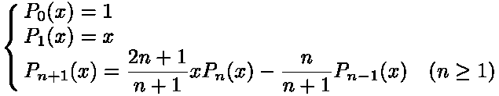

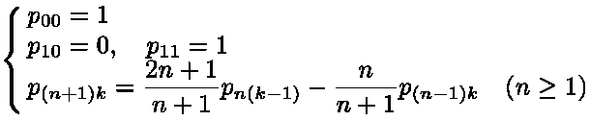
Review
Legendre polynomials
  Polynomials are recurrent.
  Coefficients are also recurrent.

Slide 18
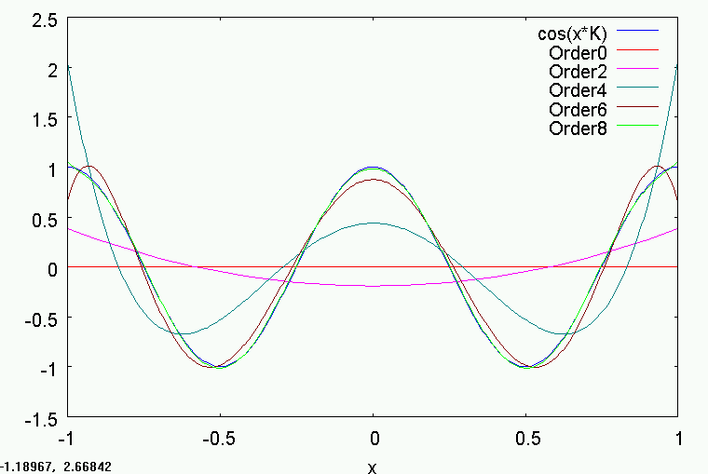
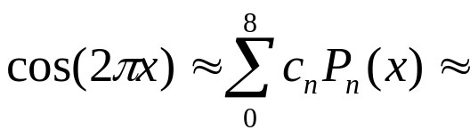

Review
Notes:
Pnx:sum((-1)^k*factorial(2*n-2*k)*x^(n-2*k)/2^n/factorial(k)/factorial(n-k)/factorial(n -2*k),k,0,floor(n/2));
ev(Pnx,n=0);
ev(Pnx,n=1);
romberg(ev(Pnx,n=0)*ev(Pnx,n=1),x,-1,1);
romberg(ev(Pnx,n=1)*ev(Pnx,n=1),x,-1,1);
romberg(ev(Pnx,n=5)*ev(Pnx,n=5),x,-1,1);
K:%pi*2;
C0:(2*0+1)/2*integrate(cos(x*K)*ev(Pnx,n=0),x);
c0:float(ev(C0,x=1)-ev(C0,x=-1));
C2:(2*2+1)/2*integrate(cos(x*K)*ev(Pnx,n=2),x);
c2:float(ev(C2,x=1)-ev(C2,x=-1));
C4:(2*4+1)/2*integrate(cos(x*K)*ev(Pnx,n=4),x);
c4:float(ev(C4,x=1)-ev(C4,x=-1));
C6:(2*6+1)/2*integrate(cos(x*K)*ev(Pnx,n=6),x);
c6::float(ev(C6,x=1)-ev(C6,x=-1));
C8:(2*8+1)/2*integrate(cos(x*K)*ev(Pnx,n=8),x);
c8::float(ev(C8,x=1)-ev(C8,x=-1));
Approx0:c0*ev(Pnx,n=0);
Approx2:Approx0+c2*ev(Pnx,n=2);
Approx4:Approx2+c4*ev(Pnx,n=4);
Approx6:Approx4+c6*ev(Pnx,n=6);
Approx8:Approx6+c8*ev(Pnx,n=8);
plot2d([cos(x*K),Approx0,Approx2,Approx4,Approx6,Approx8],[x,-1,1],[legend,"cos(x*K)","Order0","Order2","Order4","Order6","Order8"]);

Slide 19

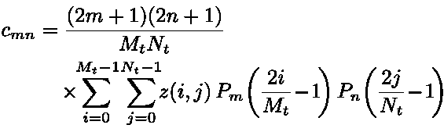
Review
Image approximation with 2D Legendre polynomials
  Given an image z(i,j) (i=0~Mt-1, j=0~Nt-1), h(x,y) be the polynomial of degree d that approximates z (x=-1~1,y=-1~1)
  Time complexity : O(MtNt*d^3)
Notes:
Pnx:sum((-1)^k*factorial(2*n-2*k)*x^(n-2*k)/2^n/factorial(k)/factorial(n-k)/factorial(n -2*k),k,0,floor(n/2));
ev(Pnx,n=0);
ev(Pnx,n=1);
romberg(ev(Pnx,n=0)*ev(Pnx,n=1),x,-1,1);
romberg(ev(Pnx,n=1)*ev(Pnx,n=1),x,-1,1);
romberg(ev(Pnx,n=5)*ev(Pnx,n=5),x,-1,1);
K:%pi*2;
C0:(2*0+1)/2*integrate(cos(x*K)*ev(Pnx,n=0),x);
c0:float(ev(C0,x=1)-ev(C0,x=-1));
C2:(2*2+1)/2*integrate(cos(x*K)*ev(Pnx,n=2),x);
c2:float(ev(C2,x=1)-ev(C2,x=-1));
C4:(2*4+1)/2*integrate(cos(x*K)*ev(Pnx,n=4),x);
c4:float(ev(C4,x=1)-ev(C4,x=-1));
C6:(2*6+1)/2*integrate(cos(x*K)*ev(Pnx,n=6),x);
c6::float(ev(C6,x=1)-ev(C6,x=-1));
C8:(2*8+1)/2*integrate(cos(x*K)*ev(Pnx,n=8),x);
c8::float(ev(C8,x=1)-ev(C8,x=-1));
Approx0:c0*ev(Pnx,n=0);
Approx2:Approx0+c2*ev(Pnx,n=2);
Approx4:Approx2+c4*ev(Pnx,n=4);
Approx6:Approx4+c6*ev(Pnx,n=6);
Approx8:Approx6+c8*ev(Pnx,n=8);
plot2d([cos(x*K),Approx0,Approx2,Approx4,Approx6,Approx8],[x,-1,1],[legend,"cos(x*K)","Order0","Order2","Order4","Order6","Order8"]);

Slide 20
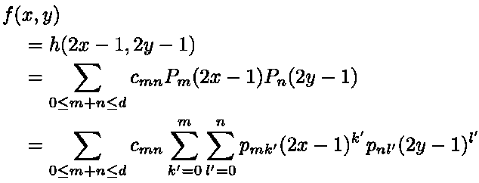
Review
Image approximation with 2D Legendre polynomials
  Approximate the image z(i,j) (i=0~Mt-1, j=0~Nt-1) by f(x,y) be the polynomial of degree d that approximates z (x=0~1,y=0~1)
  Compared with
Notes:
Pnx:sum((-1)^k*factorial(2*n-2*k)*x^(n-2*k)/2^n/factorial(k)/factorial(n-k)/factorial(n -2*k),k,0,floor(n/2));
ev(Pnx,n=0);
ev(Pnx,n=1);
romberg(ev(Pnx,n=0)*ev(Pnx,n=1),x,-1,1);
romberg(ev(Pnx,n=1)*ev(Pnx,n=1),x,-1,1);
romberg(ev(Pnx,n=5)*ev(Pnx,n=5),x,-1,1);
K:%pi*2;
C0:(2*0+1)/2*integrate(cos(x*K)*ev(Pnx,n=0),x);
c0:float(ev(C0,x=1)-ev(C0,x=-1));
C2:(2*2+1)/2*integrate(cos(x*K)*ev(Pnx,n=2),x);
c2:float(ev(C2,x=1)-ev(C2,x=-1));
C4:(2*4+1)/2*integrate(cos(x*K)*ev(Pnx,n=4),x);
c4:float(ev(C4,x=1)-ev(C4,x=-1));
C6:(2*6+1)/2*integrate(cos(x*K)*ev(Pnx,n=6),x);
c6::float(ev(C6,x=1)-ev(C6,x=-1));
C8:(2*8+1)/2*integrate(cos(x*K)*ev(Pnx,n=8),x);
c8::float(ev(C8,x=1)-ev(C8,x=-1));
Approx0:c0*ev(Pnx,n=0);
Approx2:Approx0+c2*ev(Pnx,n=2);
Approx4:Approx2+c4*ev(Pnx,n=4);
Approx6:Approx4+c6*ev(Pnx,n=6);
Approx8:Approx6+c8*ev(Pnx,n=8);
plot2d([cos(x*K),Approx0,Approx2,Approx4,Approx6,Approx8],[x,-1,1],[legend,"cos(x*K)","Order0","Order2","Order4","Order6","Order8"]);

Slide 21


Review
Image approximation with 2D Legendre polynomials
  We can calculate the coefficients of
  As
  Instead of O(d^6), time complexity for all a_{kl}: O(d^4)
Notes:
Pnx:sum((-1)^k*factorial(2*n-2*k)*x^(n-2*k)/2^n/factorial(k)/factorial(n-k)/factorial(n -2*k),k,0,floor(n/2));
ev(Pnx,n=0);
ev(Pnx,n=1);
romberg(ev(Pnx,n=0)*ev(Pnx,n=1),x,-1,1);
romberg(ev(Pnx,n=1)*ev(Pnx,n=1),x,-1,1);
romberg(ev(Pnx,n=5)*ev(Pnx,n=5),x,-1,1);
K:%pi*2;
C0:(2*0+1)/2*integrate(cos(x*K)*ev(Pnx,n=0),x);
c0:float(ev(C0,x=1)-ev(C0,x=-1));
C2:(2*2+1)/2*integrate(cos(x*K)*ev(Pnx,n=2),x);
c2:float(ev(C2,x=1)-ev(C2,x=-1));
C4:(2*4+1)/2*integrate(cos(x*K)*ev(Pnx,n=4),x);
c4:float(ev(C4,x=1)-ev(C4,x=-1));
C6:(2*6+1)/2*integrate(cos(x*K)*ev(Pnx,n=6),x);
c6::float(ev(C6,x=1)-ev(C6,x=-1));
C8:(2*8+1)/2*integrate(cos(x*K)*ev(Pnx,n=8),x);
c8::float(ev(C8,x=1)-ev(C8,x=-1));
Approx0:c0*ev(Pnx,n=0);
Approx2:Approx0+c2*ev(Pnx,n=2);
Approx4:Approx2+c4*ev(Pnx,n=4);
Approx6:Approx4+c6*ev(Pnx,n=6);
Approx8:Approx6+c8*ev(Pnx,n=8);
plot2d([cos(x*K),Approx0,Approx2,Approx4,Approx6,Approx8],[x,-1,1],[legend,"cos(x*K)","Order0","Order2","Order4","Order6","Order8"]);

Slide 22
Review
Image approximation with 2D Legendre polynomials
n
=
-
-
+
l
m
In order to acieve O(d^4), the integral image I(x,y) should be calculated first
O
k
m+n≤d
Notes:
Pnx:sum((-1)^k*factorial(2*n-2*k)*x^(n-2*k)/2^n/factorial(k)/factorial(n-k)/factorial(n -2*k),k,0,floor(n/2));
ev(Pnx,n=0);
ev(Pnx,n=1);
romberg(ev(Pnx,n=0)*ev(Pnx,n=1),x,-1,1);
romberg(ev(Pnx,n=1)*ev(Pnx,n=1),x,-1,1);
romberg(ev(Pnx,n=5)*ev(Pnx,n=5),x,-1,1);
K:%pi*2;
C0:(2*0+1)/2*integrate(cos(x*K)*ev(Pnx,n=0),x);
c0:float(ev(C0,x=1)-ev(C0,x=-1));
C2:(2*2+1)/2*integrate(cos(x*K)*ev(Pnx,n=2),x);
c2:float(ev(C2,x=1)-ev(C2,x=-1));
C4:(2*4+1)/2*integrate(cos(x*K)*ev(Pnx,n=4),x);
c4:float(ev(C4,x=1)-ev(C4,x=-1));
C6:(2*6+1)/2*integrate(cos(x*K)*ev(Pnx,n=6),x);
c6::float(ev(C6,x=1)-ev(C6,x=-1));
C8:(2*8+1)/2*integrate(cos(x*K)*ev(Pnx,n=8),x);
c8::float(ev(C8,x=1)-ev(C8,x=-1));
Approx0:c0*ev(Pnx,n=0);
Approx2:Approx0+c2*ev(Pnx,n=2);
Approx4:Approx2+c4*ev(Pnx,n=4);
Approx6:Approx4+c6*ev(Pnx,n=6);
Approx8:Approx6+c8*ev(Pnx,n=8);
plot2d([cos(x*K),Approx0,Approx2,Approx4,Approx6,Approx8],[x,-1,1],[legend,"cos(x*K)","Order0","Order2","Order4","Order6","Order8"]);

Slide 23
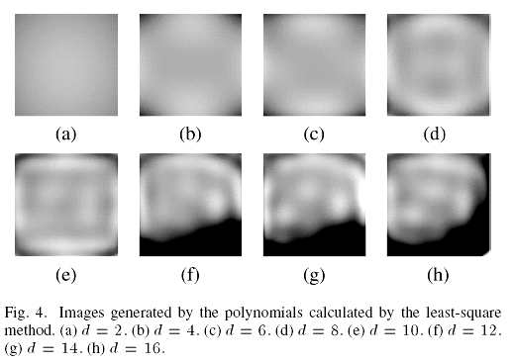
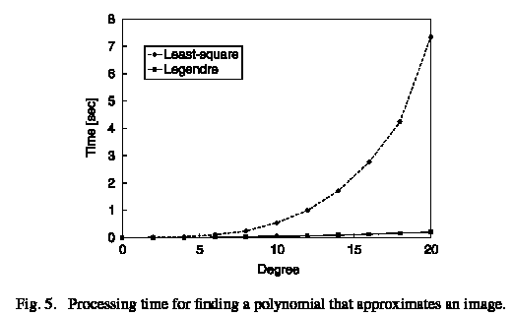
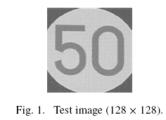
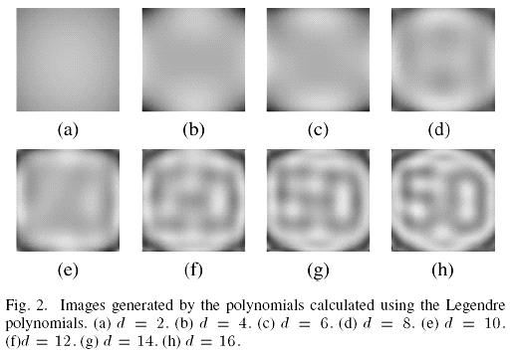
Review
Comparsion of Image approximation with 2D Legendre polynomials & the conventional method
  Conventional : O(MtNt*d^4+d^6)
  Legendre's : O(MtNt*d^3+d^4)
Notes:
Pnx:sum((-1)^k*factorial(2*n-2*k)*x^(n-2*k)/2^n/factorial(k)/factorial(n-k)/factorial(n -2*k),k,0,floor(n/2));
ev(Pnx,n=0);
ev(Pnx,n=1);
romberg(ev(Pnx,n=0)*ev(Pnx,n=1),x,-1,1);
romberg(ev(Pnx,n=1)*ev(Pnx,n=1),x,-1,1);
romberg(ev(Pnx,n=5)*ev(Pnx,n=5),x,-1,1);
K:%pi*2;
C0:(2*0+1)/2*integrate(cos(x*K)*ev(Pnx,n=0),x);
c0:float(ev(C0,x=1)-ev(C0,x=-1));
C2:(2*2+1)/2*integrate(cos(x*K)*ev(Pnx,n=2),x);
c2:float(ev(C2,x=1)-ev(C2,x=-1));
C4:(2*4+1)/2*integrate(cos(x*K)*ev(Pnx,n=4),x);
c4:float(ev(C4,x=1)-ev(C4,x=-1));
C6:(2*6+1)/2*integrate(cos(x*K)*ev(Pnx,n=6),x);
c6::float(ev(C6,x=1)-ev(C6,x=-1));
C8:(2*8+1)/2*integrate(cos(x*K)*ev(Pnx,n=8),x);
c8::float(ev(C8,x=1)-ev(C8,x=-1));
Approx0:c0*ev(Pnx,n=0);
Approx2:Approx0+c2*ev(Pnx,n=2);
Approx4:Approx2+c4*ev(Pnx,n=4);
Approx6:Approx4+c6*ev(Pnx,n=6);
Approx8:Approx6+c8*ev(Pnx,n=8);
plot2d([cos(x*K),Approx0,Approx2,Approx4,Approx6,Approx8],[x,-1,1],[legend,"cos(x*K)","Order0","Order2","Order4","Order6","Order8"]);

Slide 24
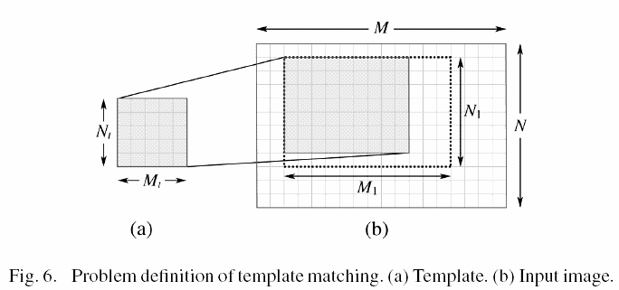
Pattern Matching
Problem Definition
  Given an template image and an input image, the partial image in the input image most similar to the template, regardless of location, width, and height, is detected.

Slide 25
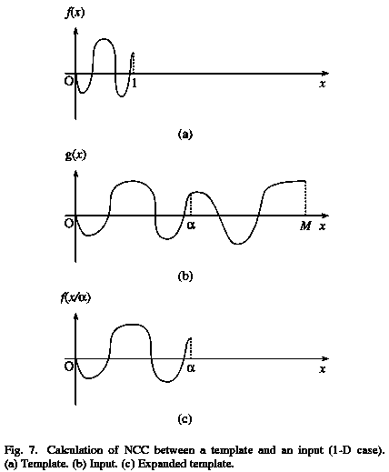
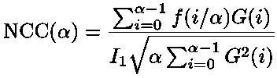
Pattern Matching
Normalization Cross Correlation (1D)
  Given a template f(x) (x=0~1) and an input g(x) (x=0~M) shown in Fig. 7(a) and (b), we can calculate the normalized cross correlation NCC(α) between g(x) and f(x/α) to find the maximum NCC. f(x/α) is an expanded or contracted pattern of , as shown in Fig. 7(c). If the origin is fixed, NCC(α) can be written as

Slide 26
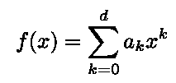
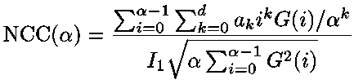
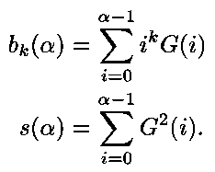

Pattern Matching
Normalization Cross Correlation (1D)
  If the template f(x) is expressed by a polynomial
  Then the NCC can be written as (α=1~M)
  Let

Slide 27
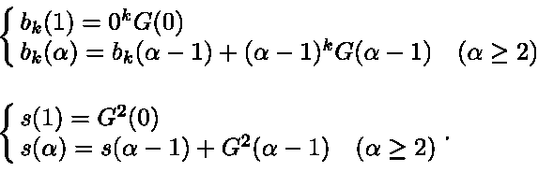
Pattern Matching
Normalization Cross Correlation (1D)
  Because b_{k}(α) & s(α) can be recurrently obtained
  Instead of O(αd), α=1~M, each NCC(α) can be calculated with O(d)
  There are M NCC(α), and thus it takes totally O(Md) time to compute all NCCs.

Slide 28

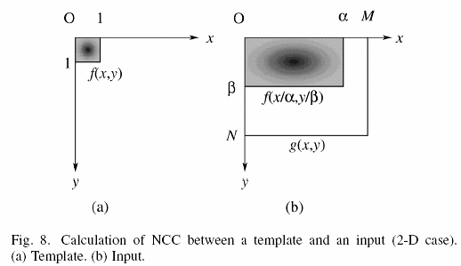
Pattern Matching
Normalization Cross Correlation (2D)
  Given a template f(x,y) and an input g(x,y), NCC(α,β) is defined as the normalized cross correlation between g(x,y) and NCC(x/α,y/β) (α=1~M, β=1~N) as shown in Fig. 8. Let the intensity of the ith column and the jth row of the input image be G(i,j) and the template be

Slide 29
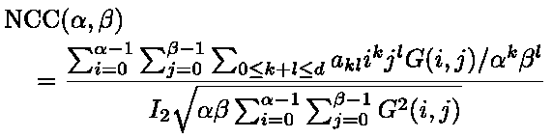
Pattern Matching
Normalization Cross Correlation (2D)
  NCC(α,β) is written as
  Time complexity to obtain each NCC(α,β) is O(αβd²) (α=1~M, β=1~N) . The total cost is O(MNαβd²)

Slide 30
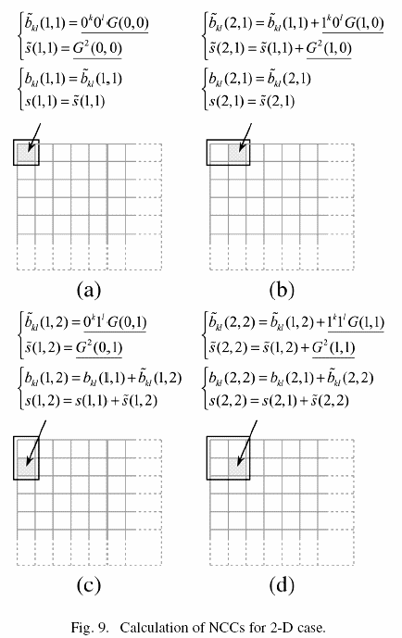
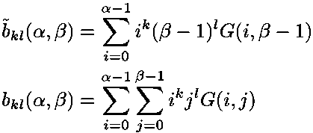
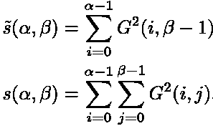
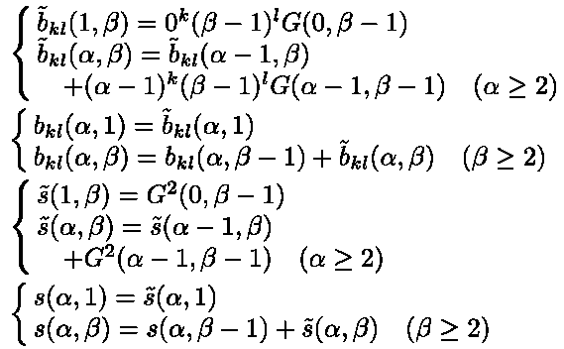
Pattern Matching
Normalization Cross Correlation (2D)
  Define
  Then rewrite recurrently

Slide 31

Pattern Matching
Normalization Cross Correlation (2D)
  NCC(α,β) is rewritten as
  Time complexity to obtain each NCC(α,β) is O(d²) for α=1~M, β=1~N . The total cost is O(MNd²)
Comparison to get all NCC(α,β)
  Conventional: O(MNαβd²) ⇒O(M²N²d²)
  ATM: O(MNd²)

Slide 32
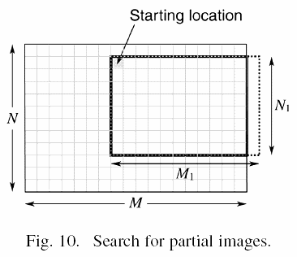
Pattern Matching
2D template matching by ATM
Time complexity comparison
  Conventional: O(MNM₁²N₁²d²)
  ATM: O(MNM₁N₁d²)
  FFT: O(M₁N₁MN*log(MN))，α=1~M₁, β=1~N₁，每一位置均須對MxN影像進行FT
  VFTM: O(MNM₁N₁d⁴)，共須移動MN位置，每一α, β為O(d⁴)

Slide 33
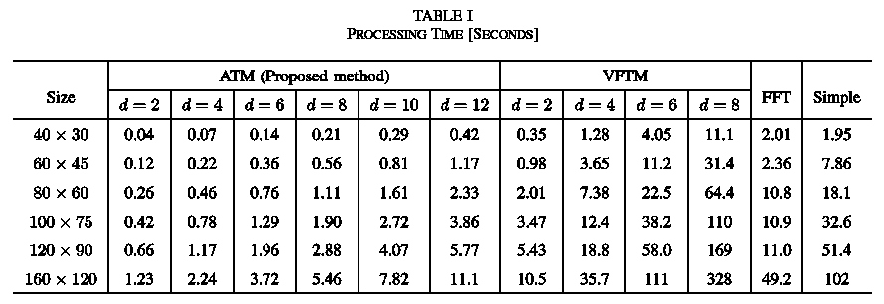
Results
Comparison

Slide 34
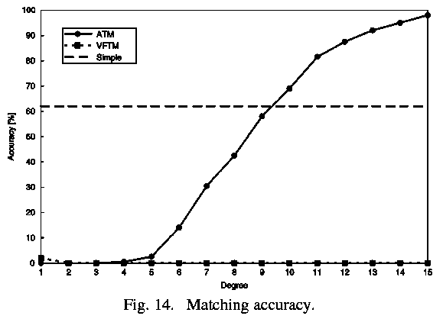
Results
Comparison
  200 320x240 input images were used for test. Each template is a partial 80x60 image from its original image. Location errors within 2 pixels are regarded as correct.

Slide 35
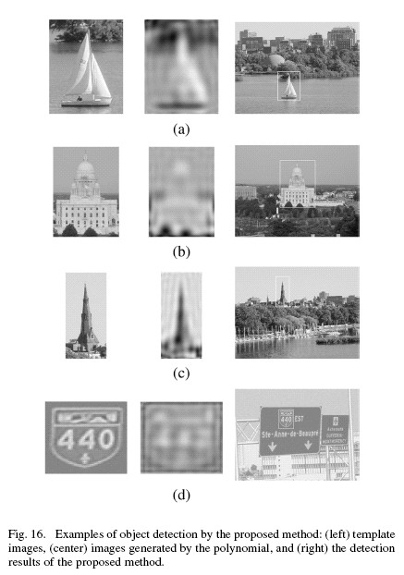
Results
Verification

Slide 36
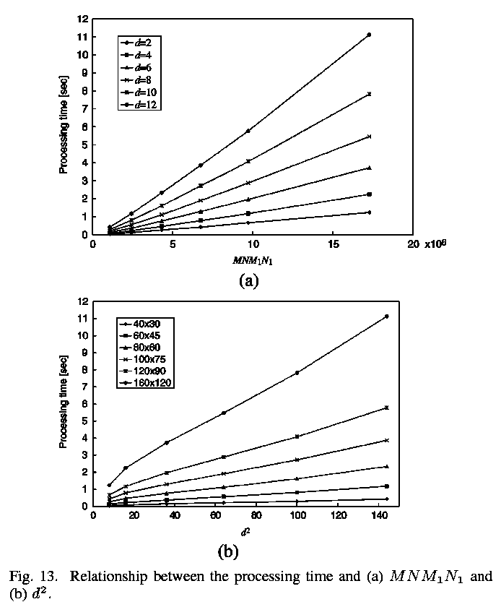
Results
Verification
  O(MNM₁N₁d²)

